Slide 1
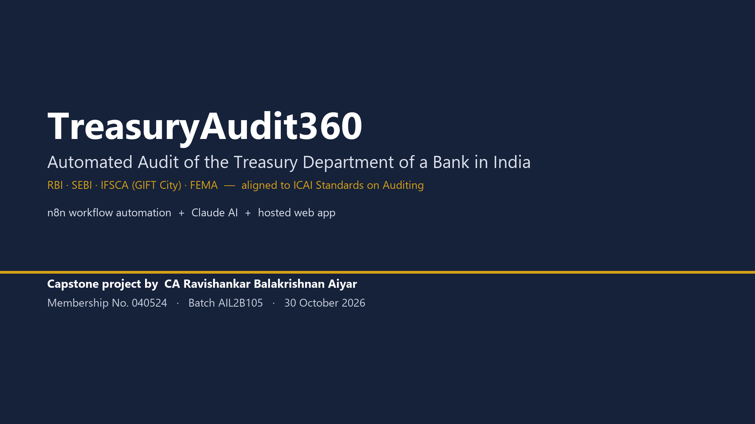
Notes:
Slide 1 - Title
Say: Introduce yourself and the project: an end-to-end automated audit of a bank's treasury, covering RBI, SEBI, IFSCA and FEMA, documented per ICAI Standards on Auditing.

Slide 2
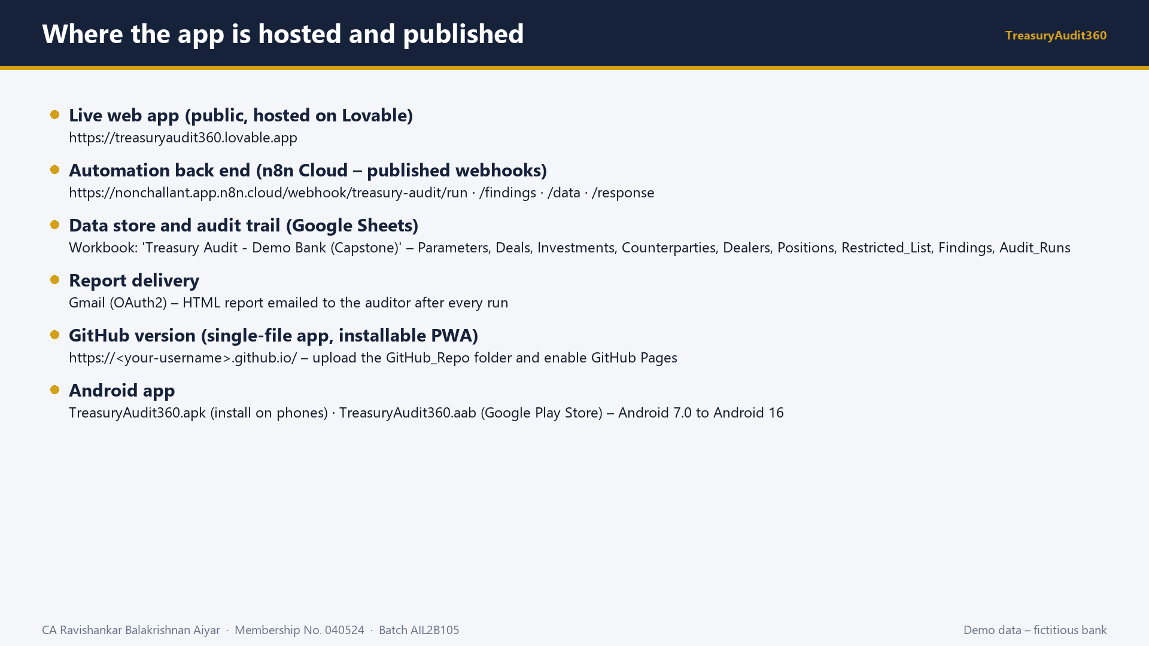
Notes:
Slide 2 - Where the app is hosted and published
Say: Show the hosting layers: the public web app on Lovable, the n8n Cloud webhooks, the Google Sheet, the GitHub Pages version and the Android app.

Slide 3
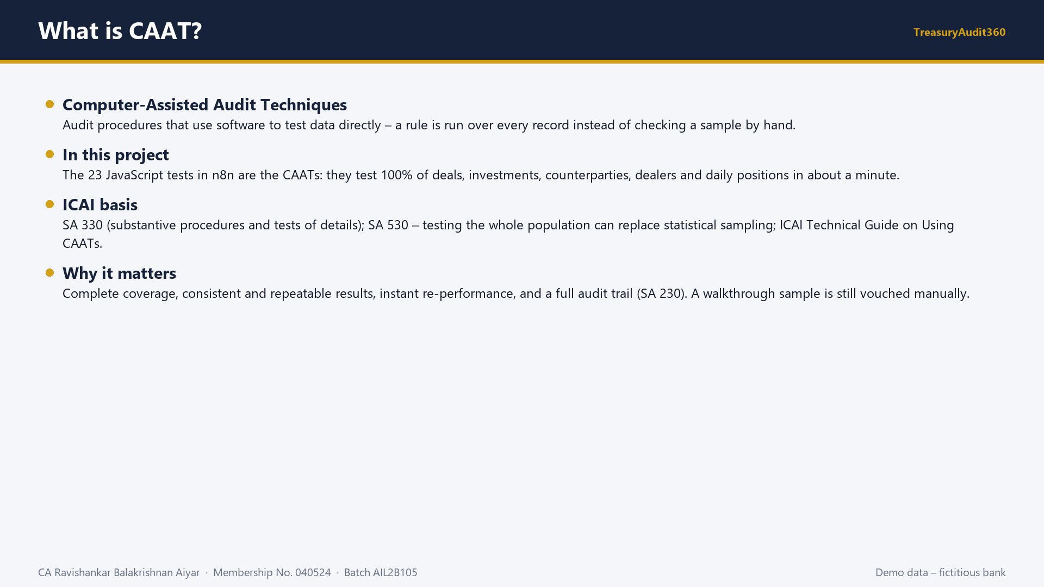
Notes:
Slide 3 - What is CAAT?
Say: Explain CAAT: computer-assisted audit techniques test every record with software. Here the 23 rules are the CAATs, giving 100 percent coverage under SA 330 and SA 530.

Slide 4
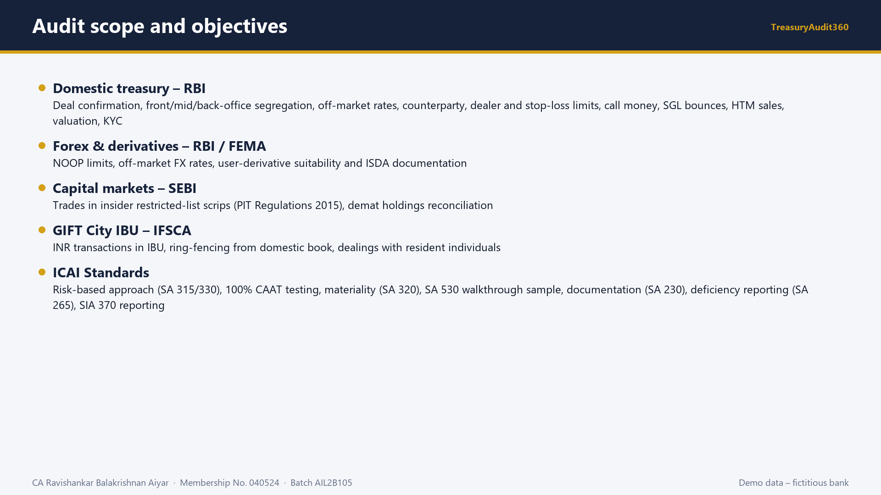
Notes:
Slide 4 - Audit scope and objectives
Say: Explain the coverage across four regulators and how the engagement is mapped to the ICAI Standards on Auditing.

Slide 5
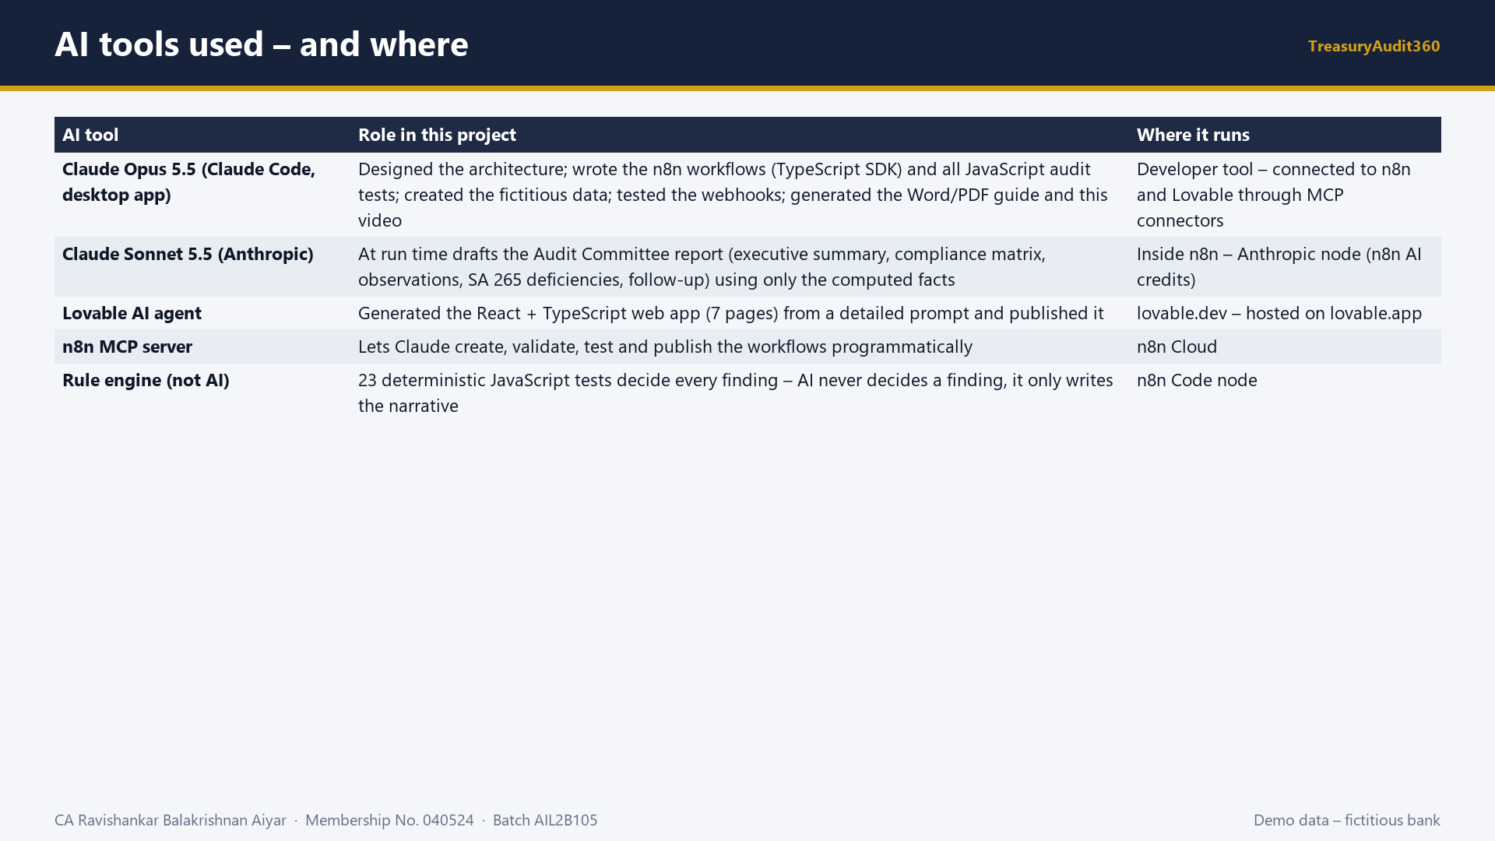
Notes:
Slide 5 - AI tools used – and where
Say: Walk through each AI tool. Stress the control: findings come from deterministic rules; Claude Sonnet only drafts the narrative from computed facts, and the auditor reviews it.

Slide 6
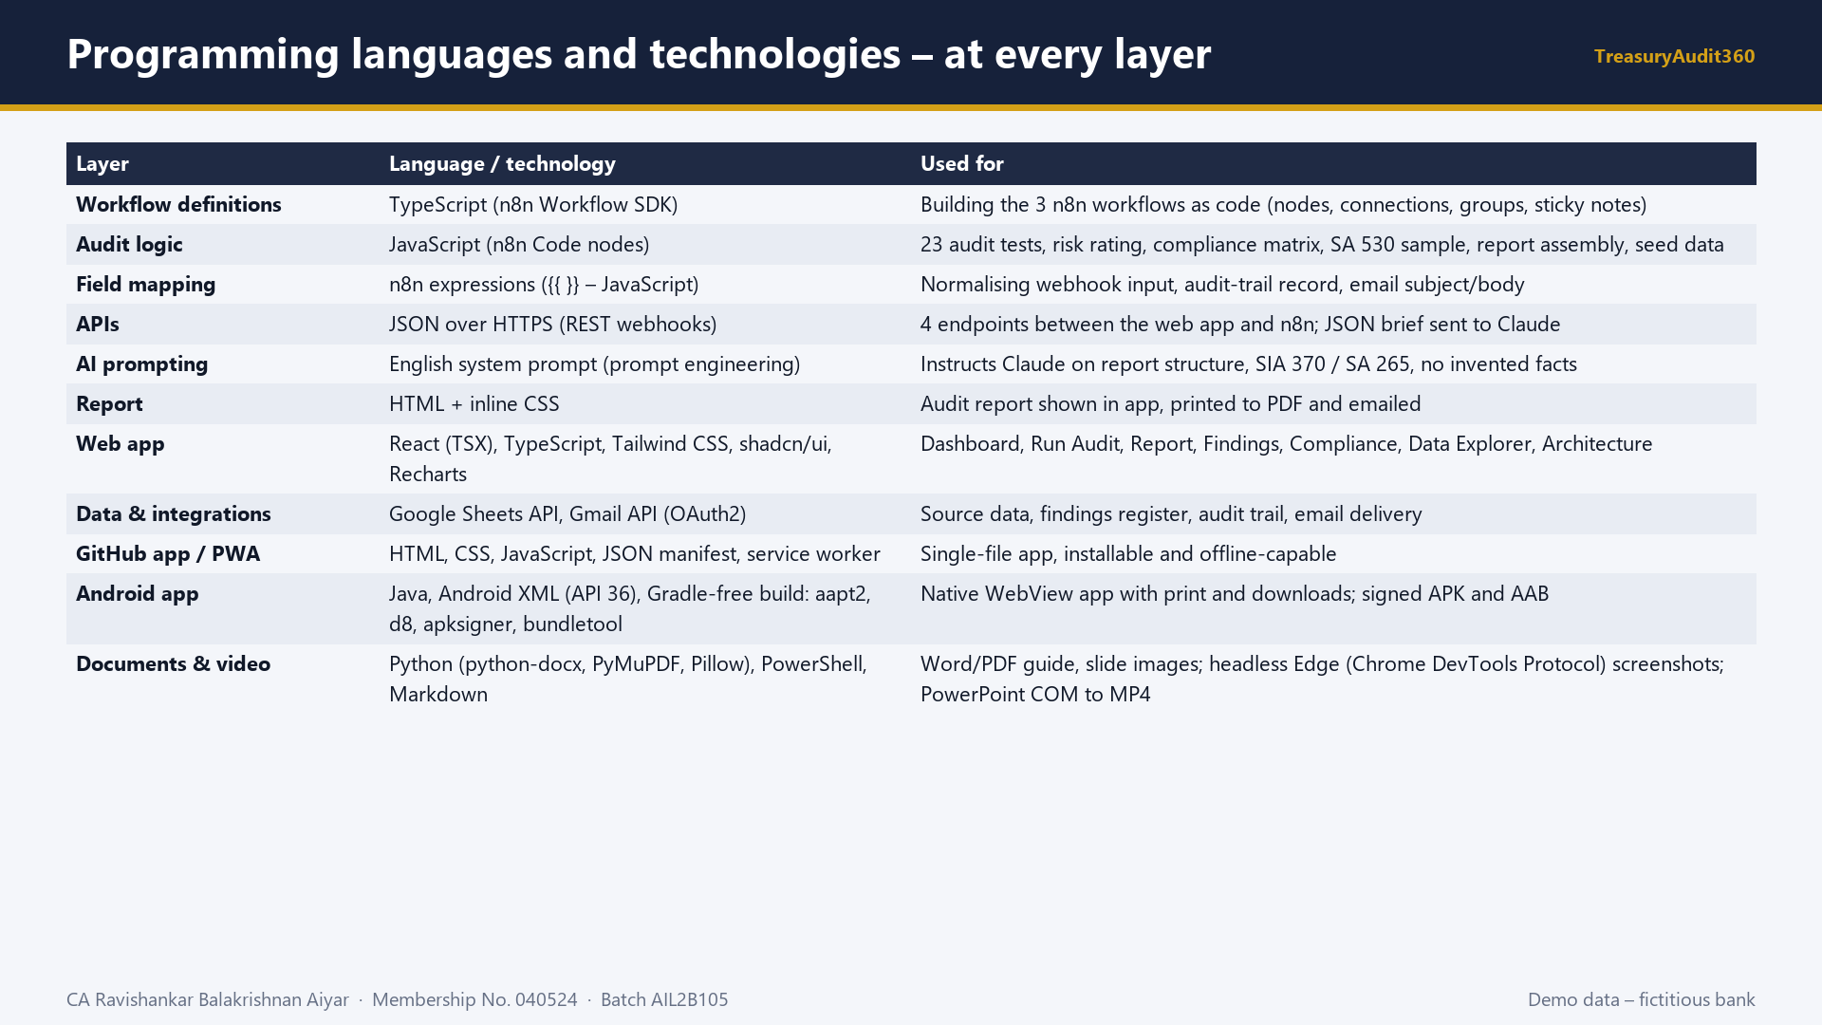
Notes:
Slide 6 - Programming languages and technologies – at every layer
Say: Explain each language at each layer: TypeScript for workflow definitions, JavaScript for the audit tests, JSON for the APIs, HTML for the report, React and TypeScript for the web app, and Python and PowerShell for the documents and this video.

Slide 7
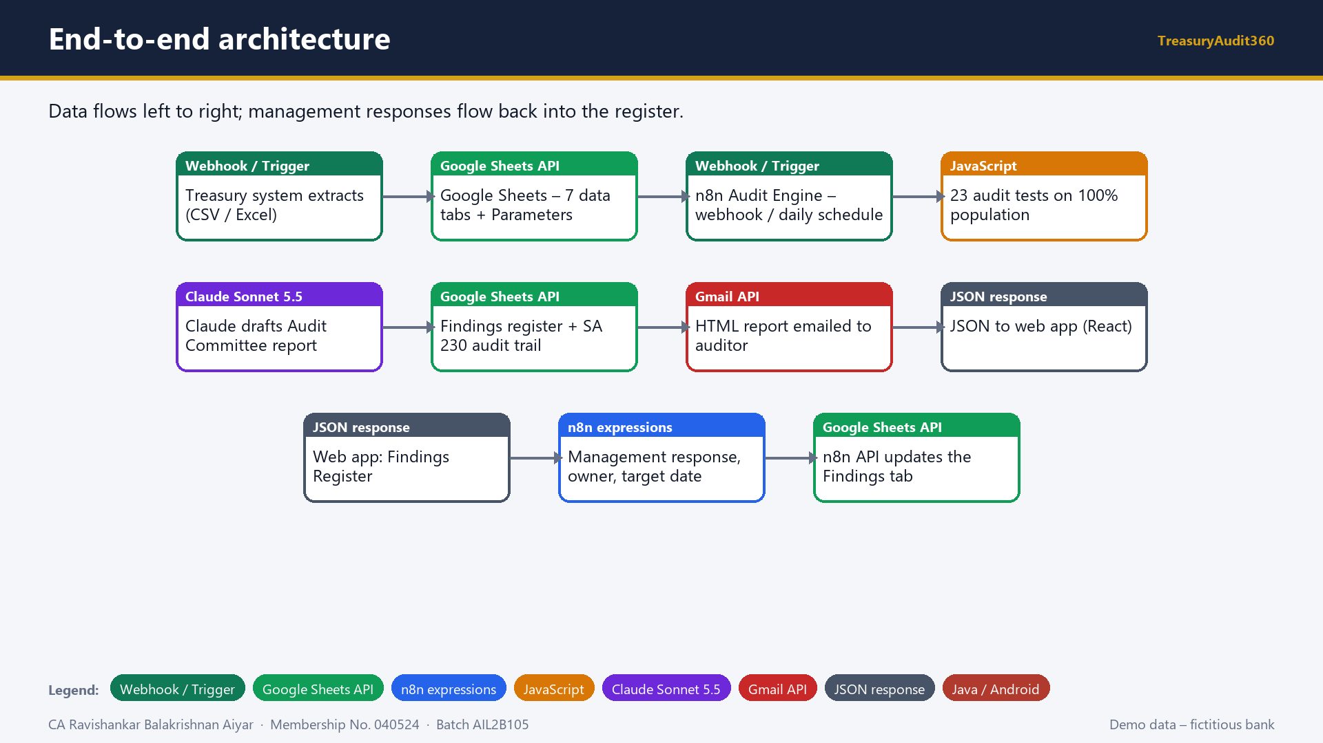
Notes:
Slide 7 - End-to-end architecture
Say: Narrate the full loop from data extraction to testing, AI drafting, documentation, email, the web app and the management response loop.

Slide 8
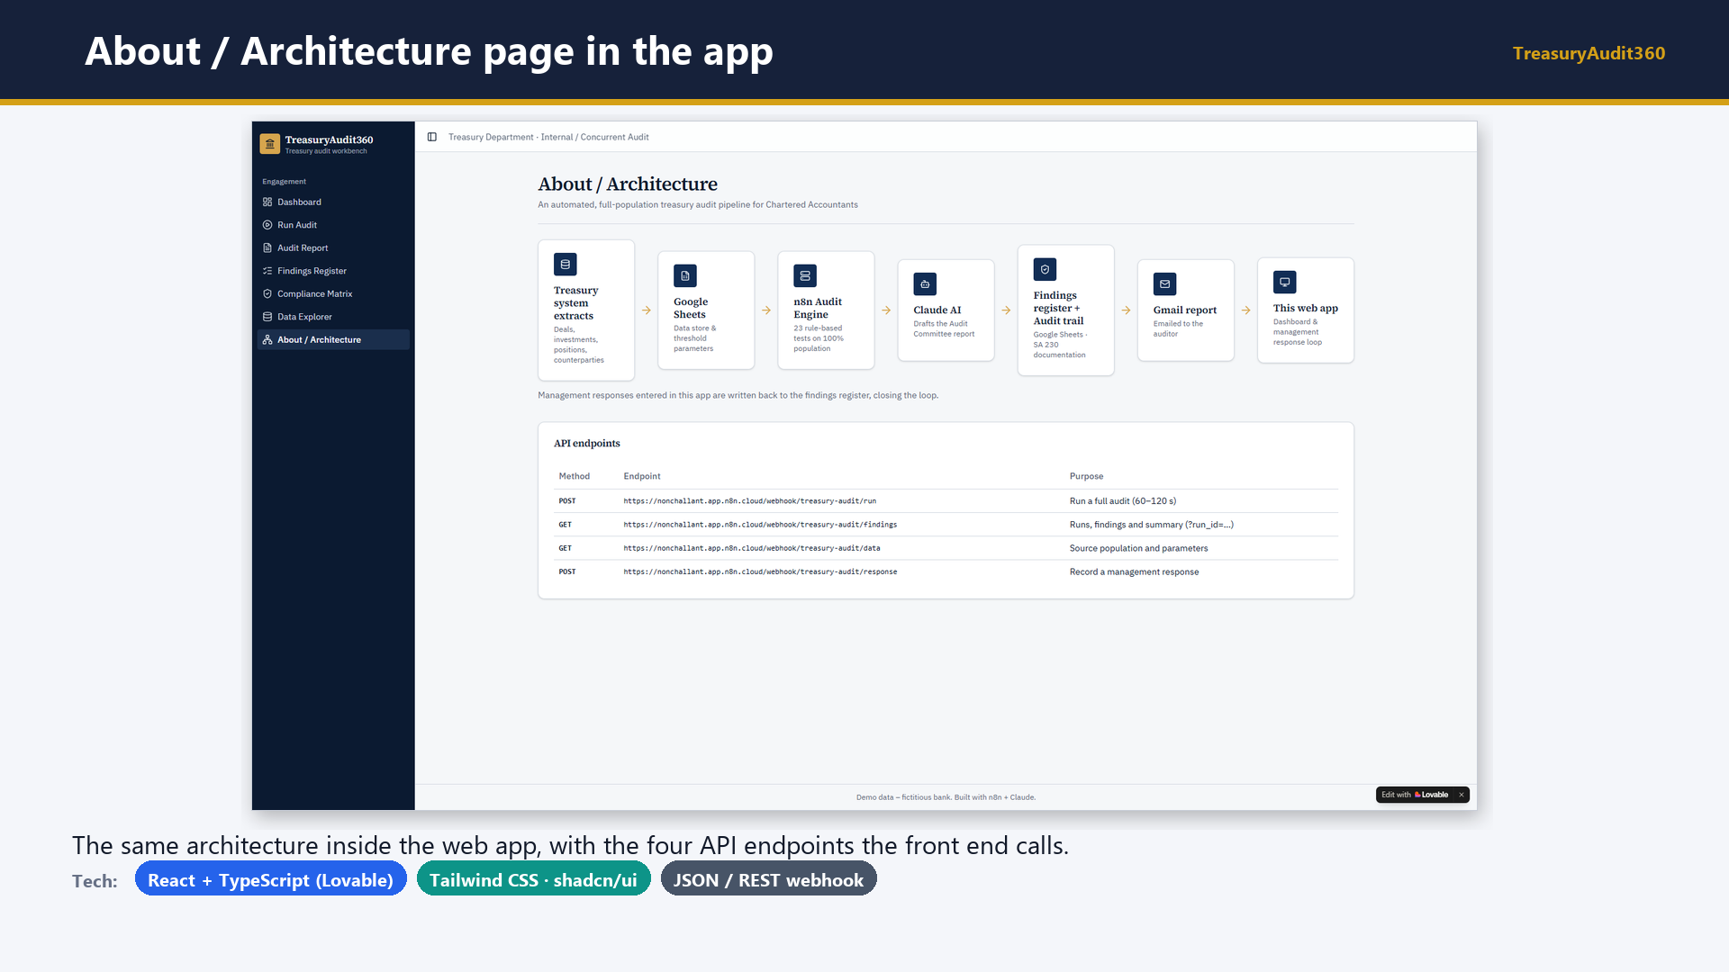
Notes:
Slide 8 - About / Architecture page in the app
Say: Show the architecture page in the app and the four endpoints.

Slide 9
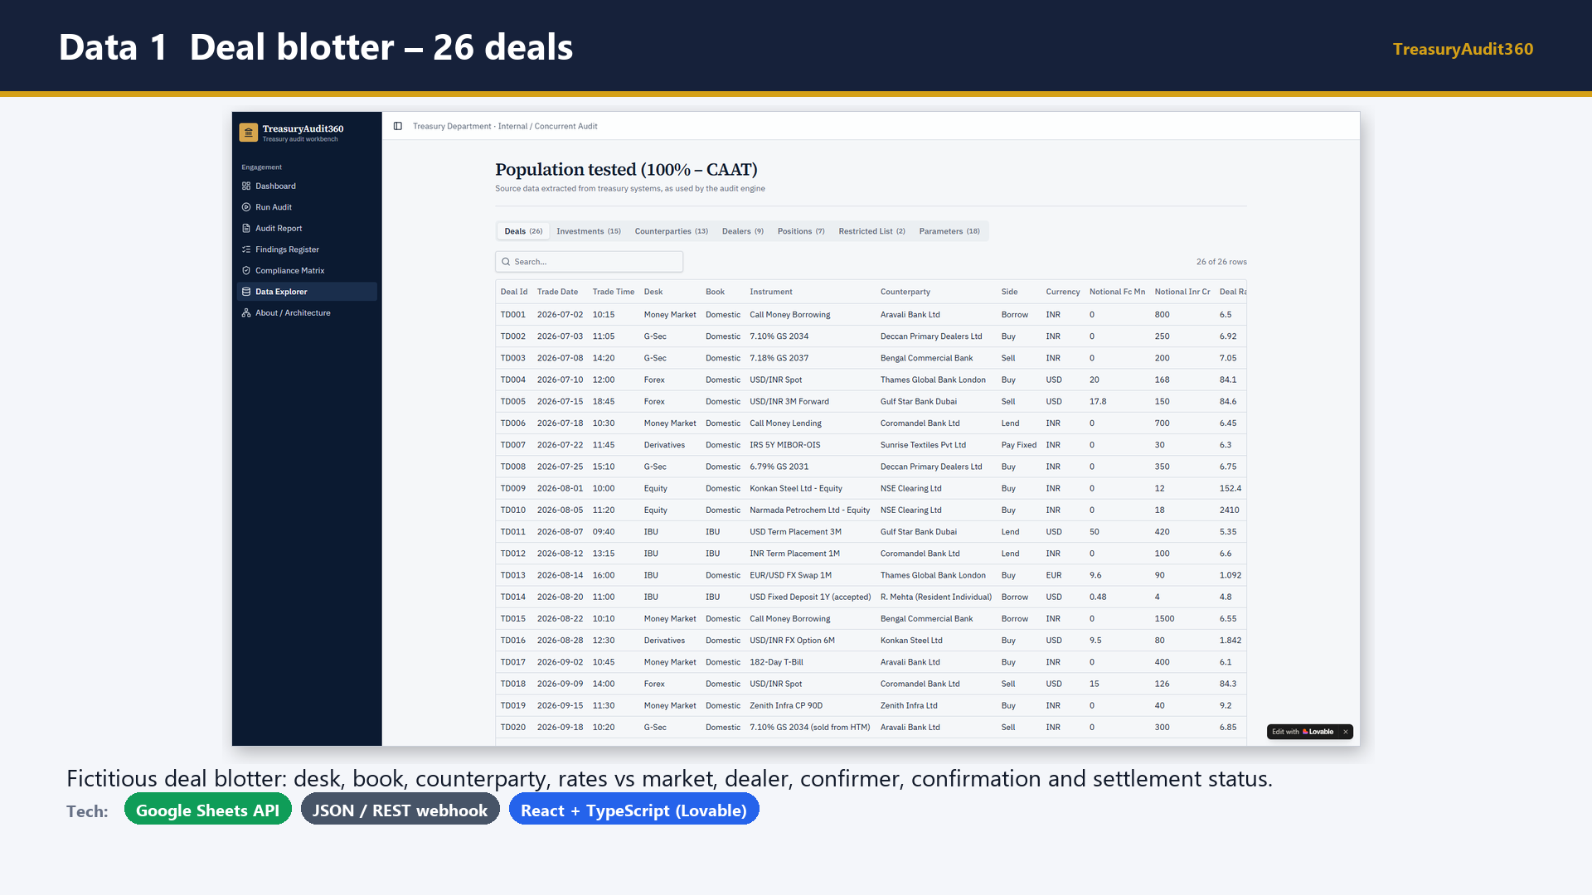
Notes:
Slide 9 - Data 1 Deal blotter – 26 deals
Say: This is the population tested: 26 treasury deals across money market, G-Sec, forex, derivatives, equity and the IBU.

Slide 10
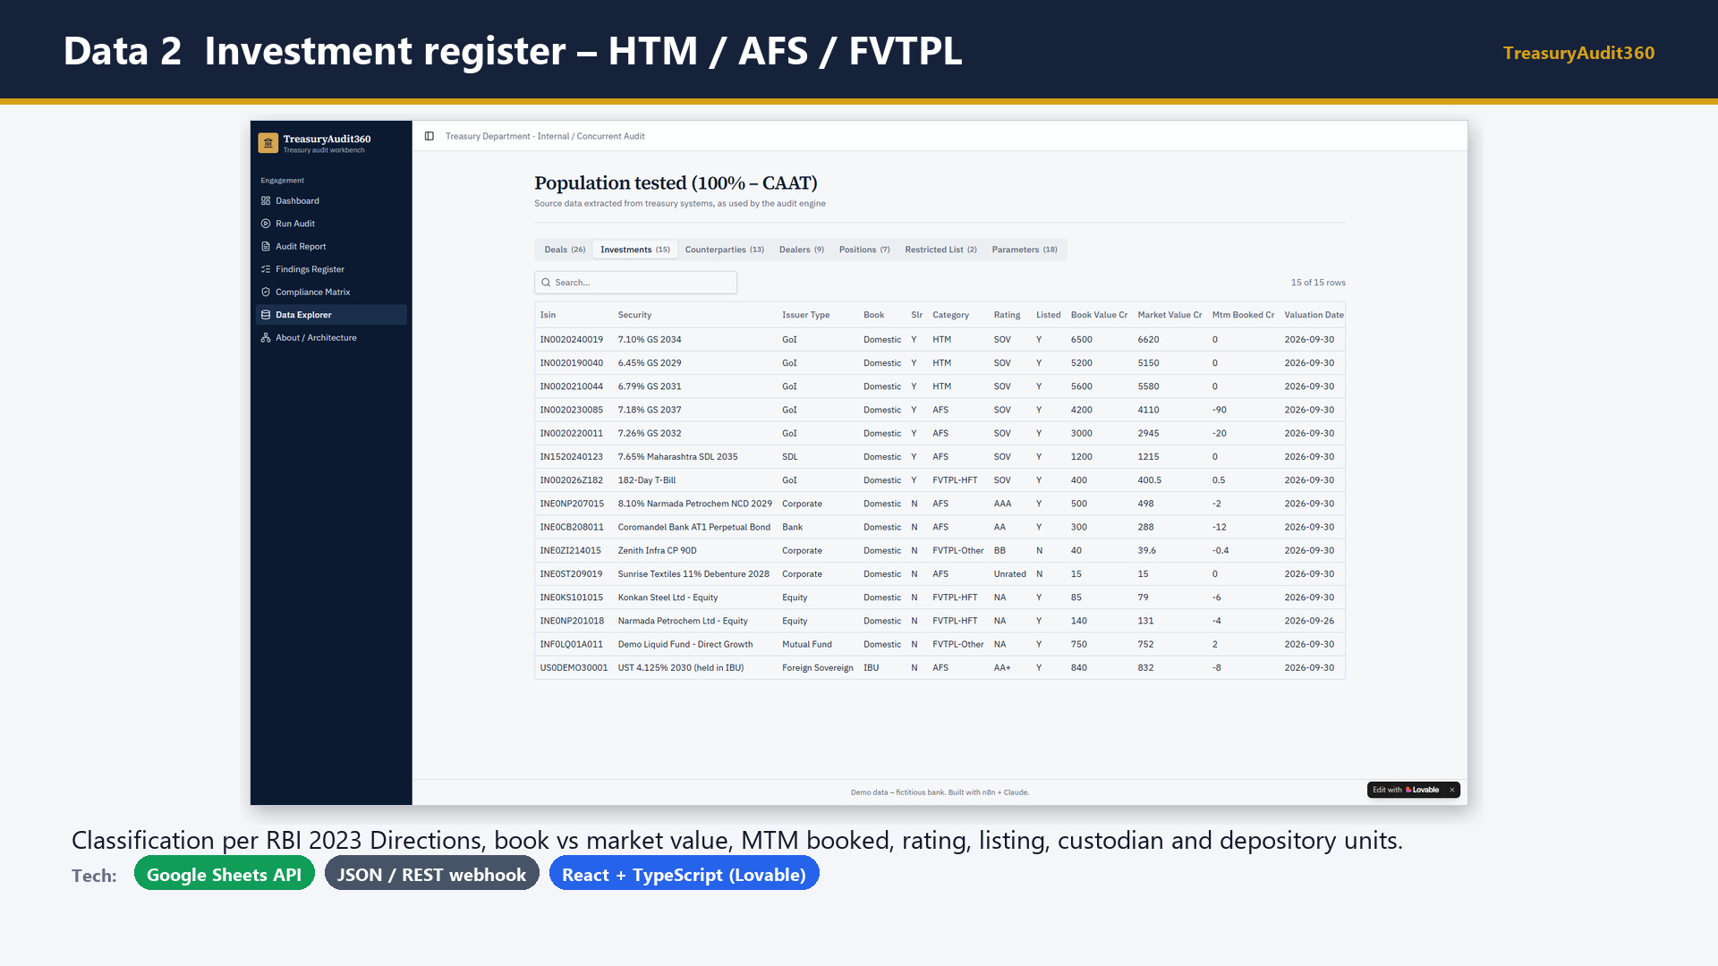
Notes:
Slide 10 - Data 2 Investment register – HTM / AFS / FVTPL
Say: The investment register supports the HTM, valuation, non-SLR and depository reconciliation tests.

Slide 11
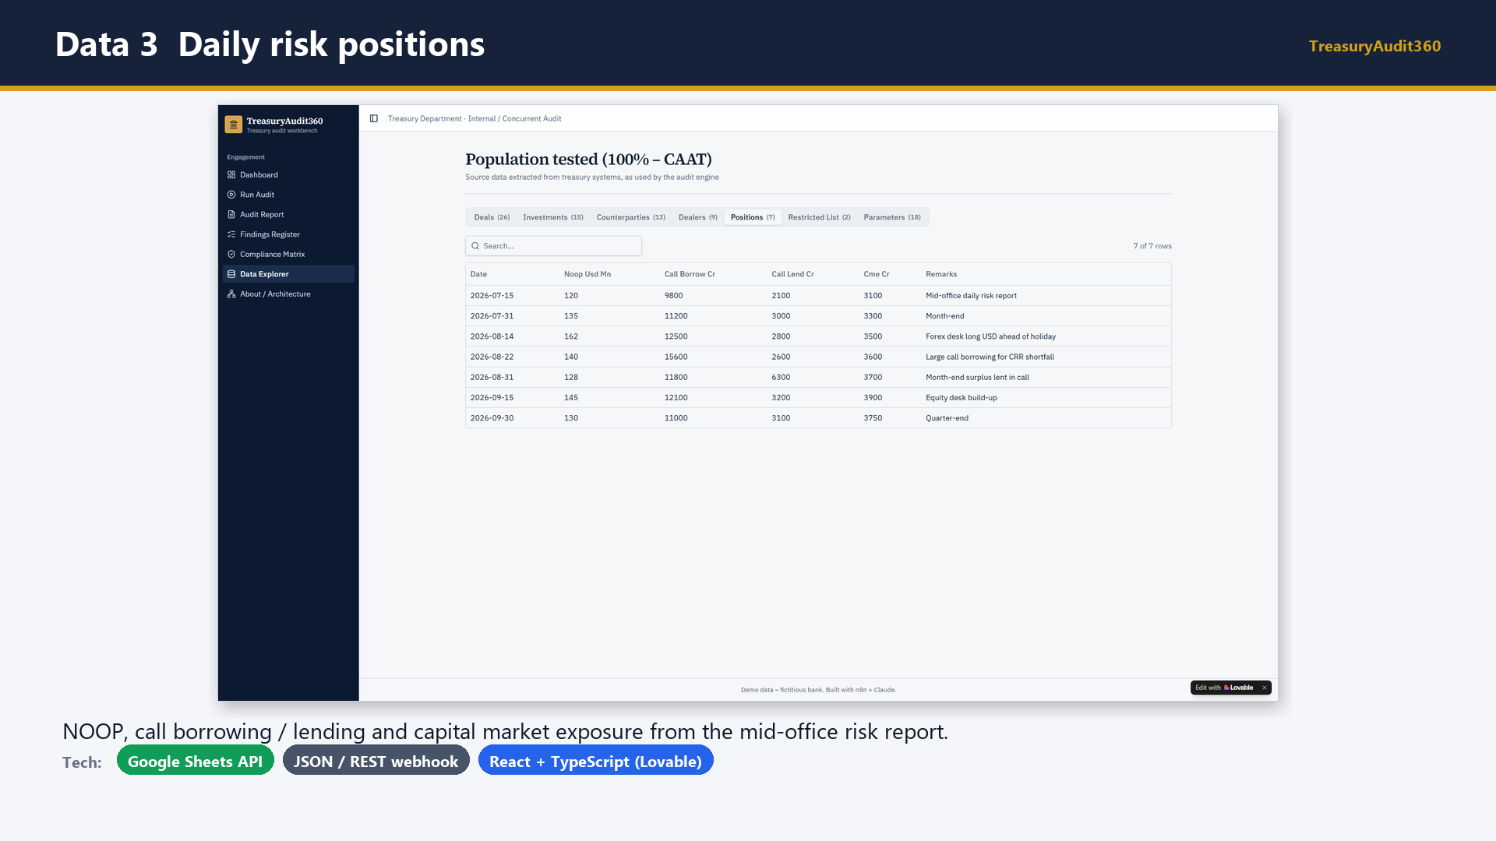
Notes:
Slide 11 - Data 3 Daily risk positions
Say: Daily positions feed the NOOP, call money and capital market exposure tests.

Slide 12
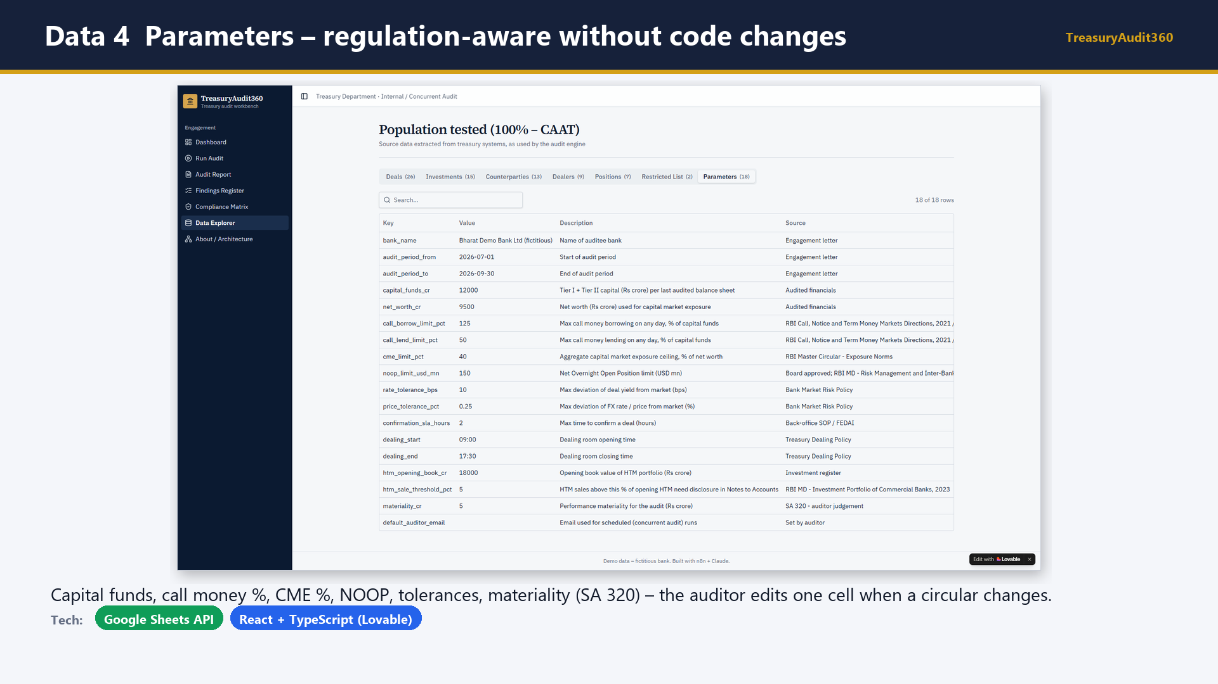
Notes:
Slide 12 - Data 4 Parameters – regulation-aware without code changes
Say: Emphasise that every regulatory threshold is a parameter, so the tool can be updated to the latest circulars without changing code.

Slide 13
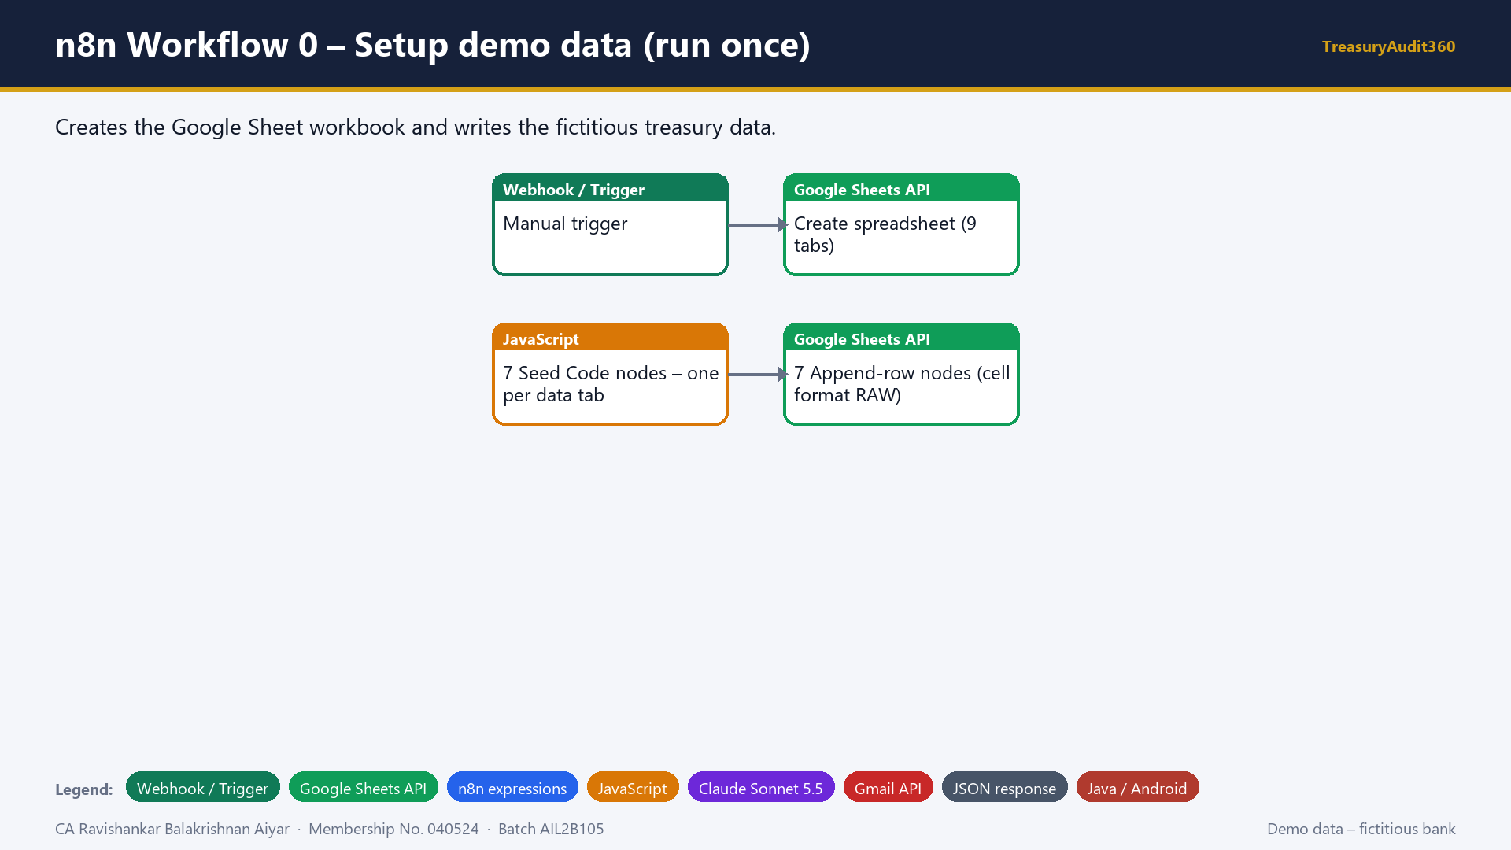
Notes:
Slide 13 - n8n Workflow 0 – Setup demo data (run once)
Say: Workflow zero is a one-time setup that creates the workbook and seeds the data.

Slide 14
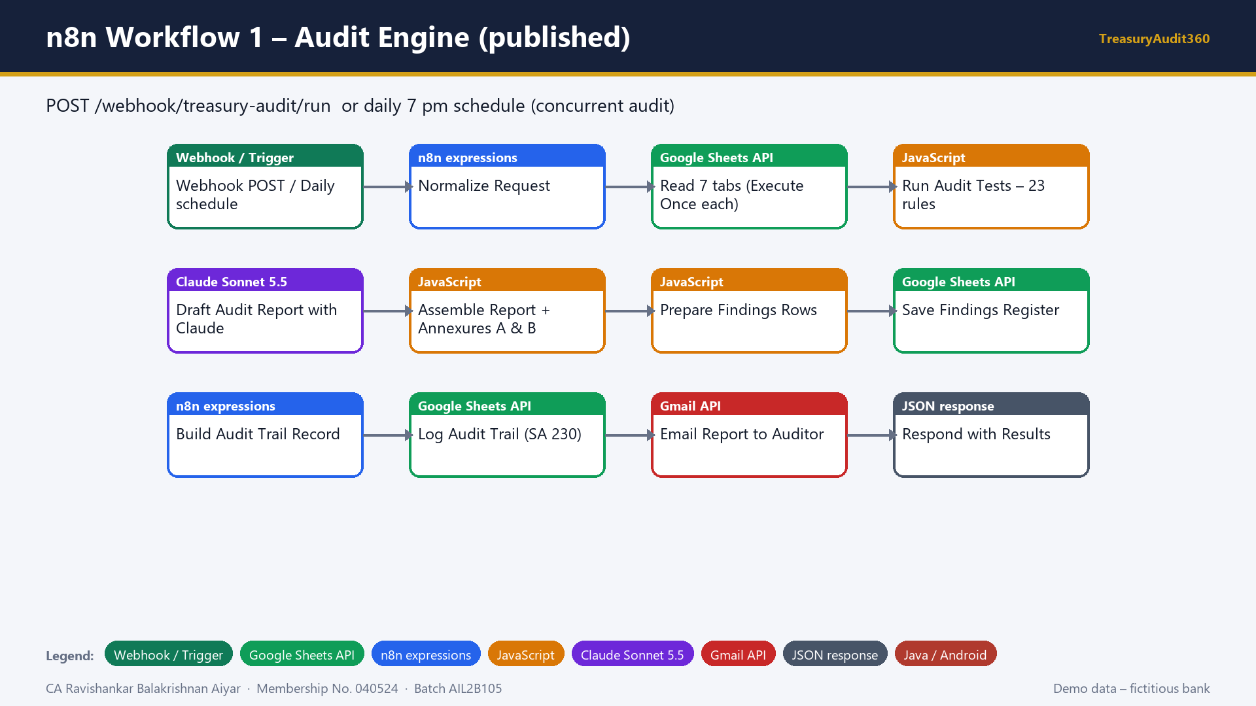
Notes:
Slide 14 - n8n Workflow 1 – Audit Engine (published)
Say: Walk node by node: trigger, normalise input, read seven tabs, run the 23 JavaScript tests, Claude drafts the report, assemble annexures, save findings and the SA 230 audit trail, email the report and respond to the web app.

Slide 15
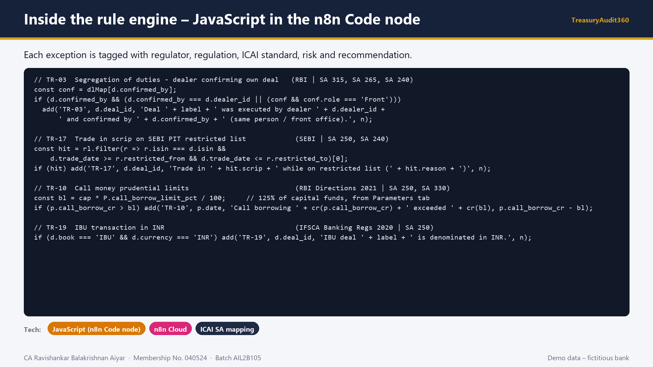
Notes:
Slide 15 - Inside the rule engine – JavaScript in the n8n Code node
Say: Show sample rules. Each rule is a few lines of JavaScript, reads its threshold from the Parameters tab and tags the exception with the regulation and ICAI standard.

Slide 16
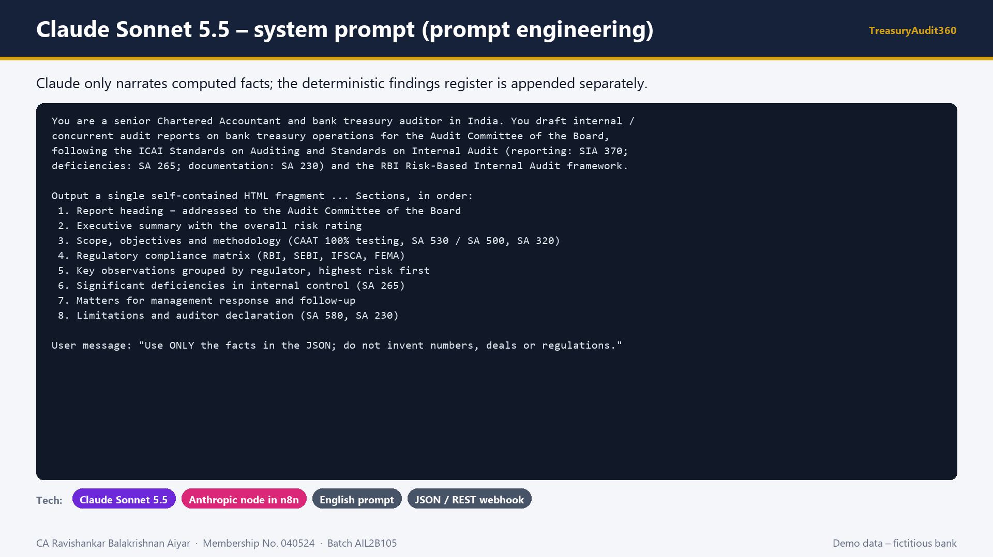
Notes:
Slide 16 - Claude Sonnet 5.5 – system prompt (prompt engineering)
Say: Explain the prompt design: role, standards, required sections, HTML output, and the instruction to use only the supplied facts.

Slide 17
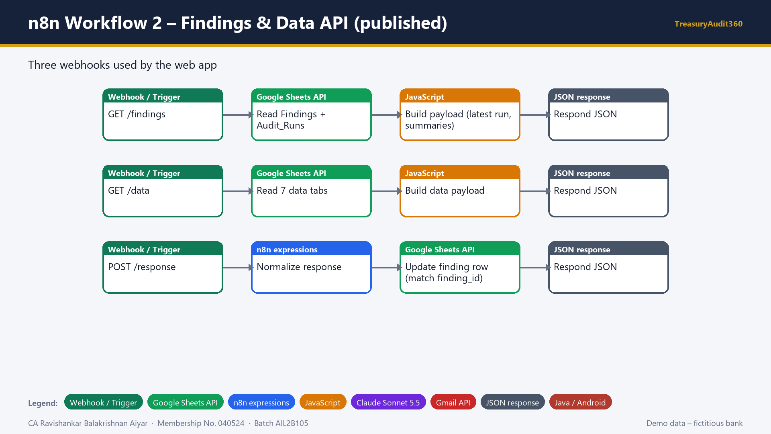
Notes:
Slide 17 - n8n Workflow 2 – Findings & Data API (published)
Say: Workflow two is the API the web app uses: read findings, read the data population and write management responses back.

Slide 18
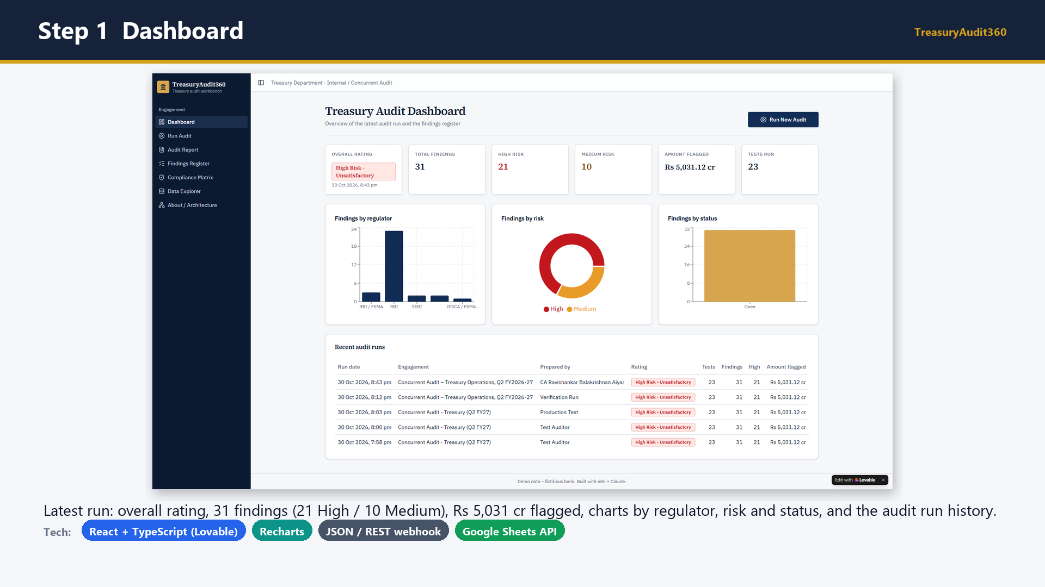
Notes:
Slide 18 - Step 1 Dashboard
Say: Open the dashboard: rating, findings, amount flagged and charts, plus the history of audit runs.

Slide 19
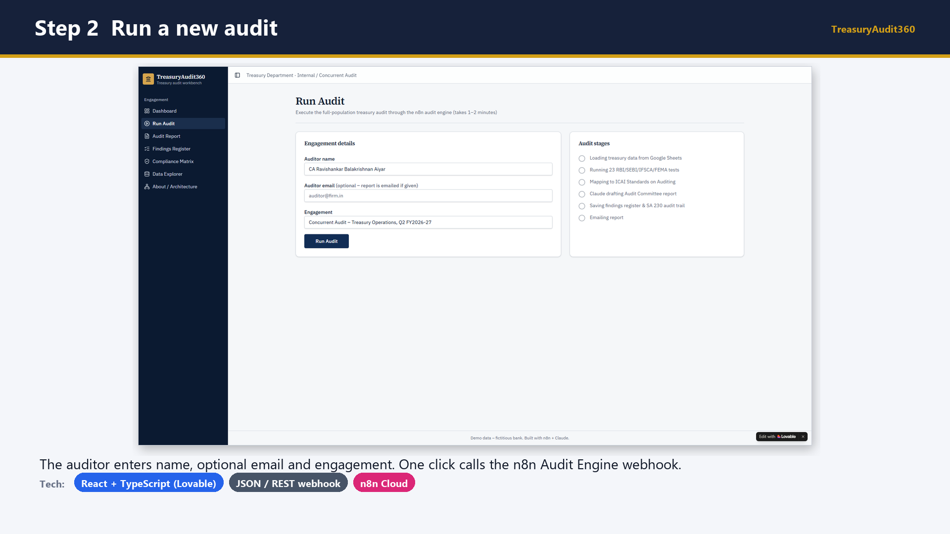
Notes:
Slide 19 - Step 2 Run a new audit
Say: Go to Run Audit, enter your name and click Run Audit.

Slide 20
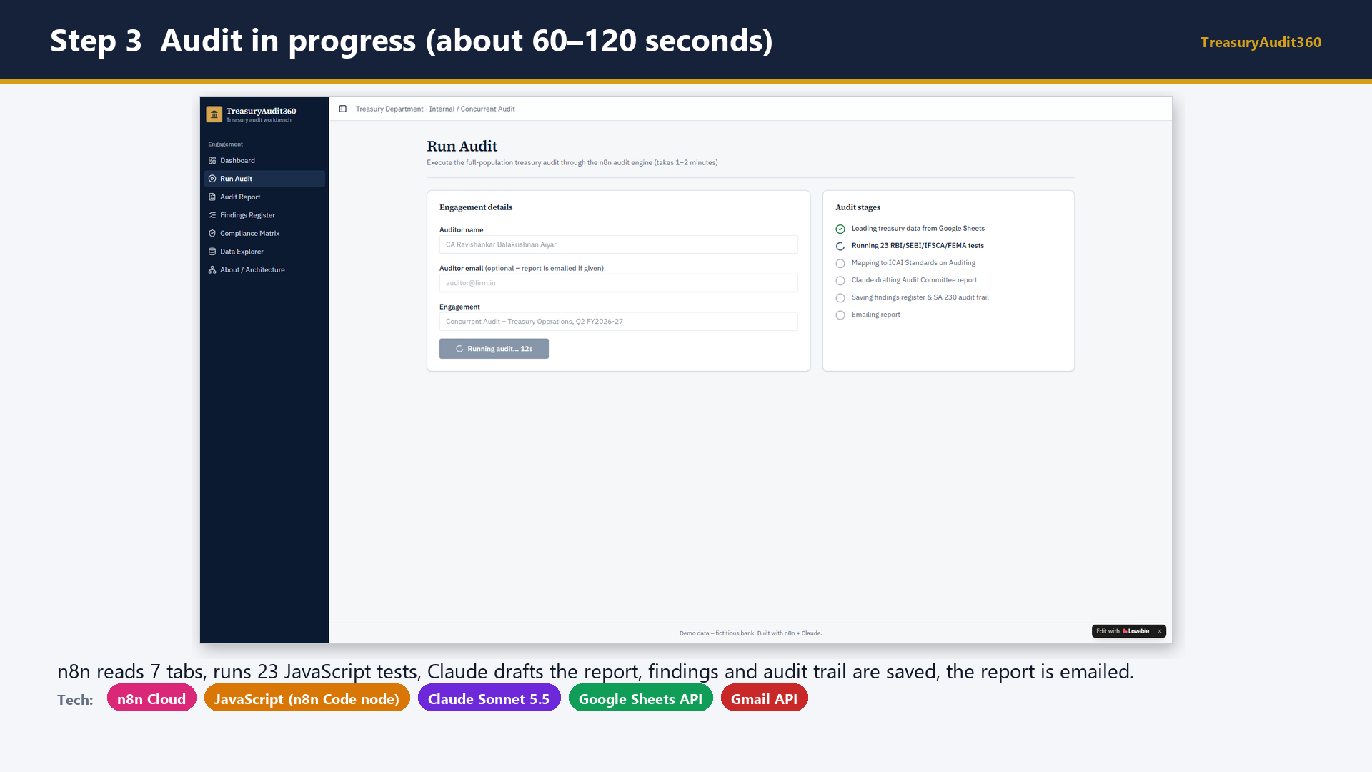
Notes:
Slide 20 - Step 3 Audit in progress (about 60–120 seconds)
Say: While the stages run, explain what n8n is doing at each stage.

Slide 21
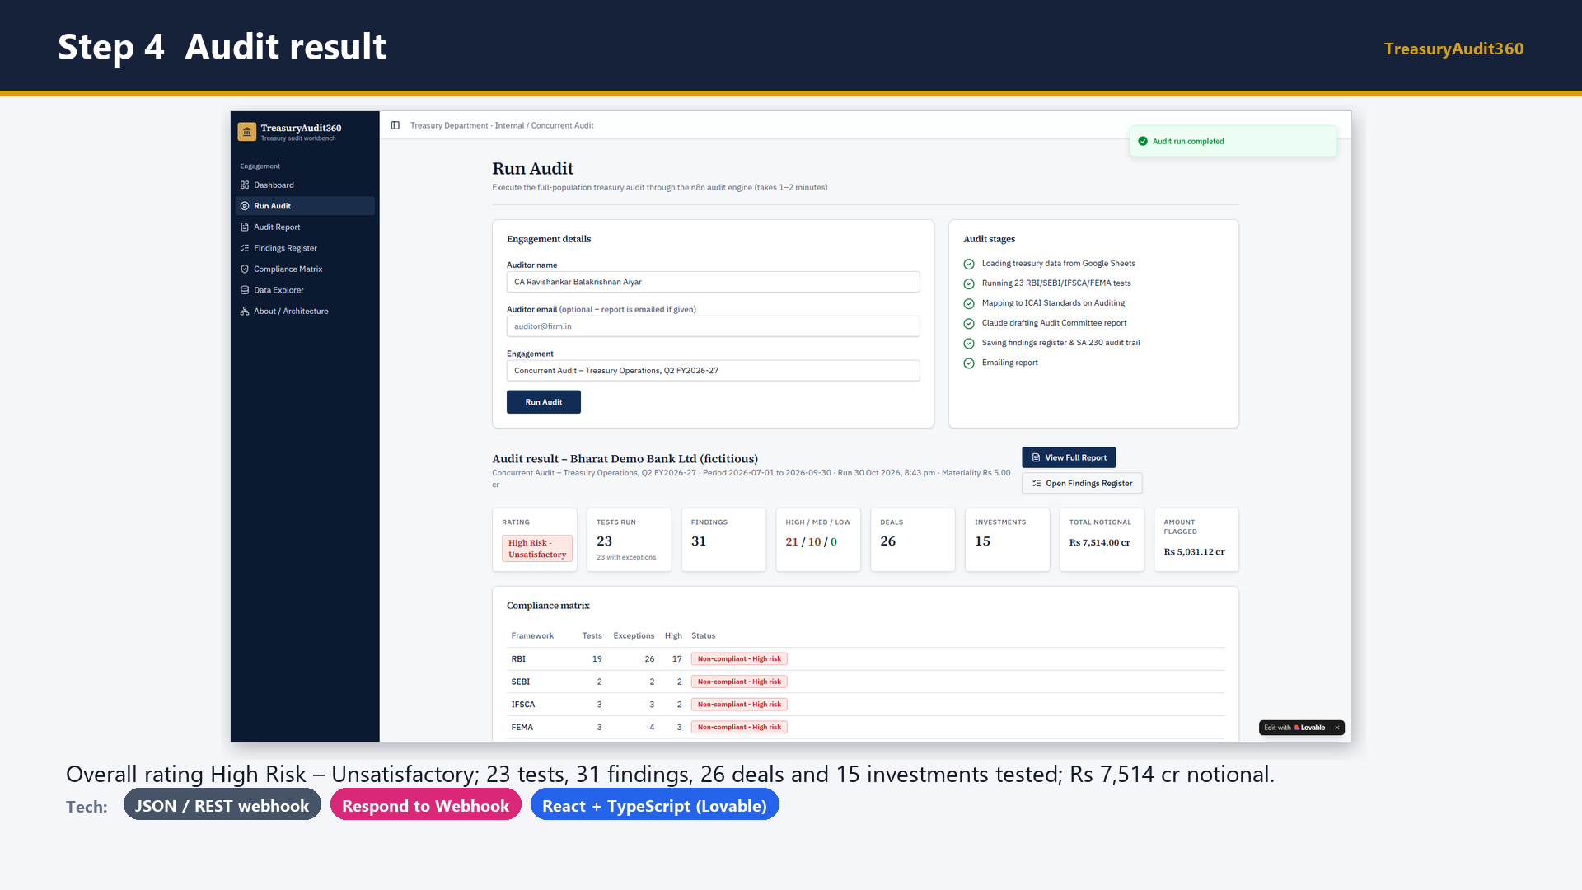
Notes:
Slide 21 - Step 4 Audit result
Say: Read out the result: rating, tests, findings, population and amount flagged.

Slide 22
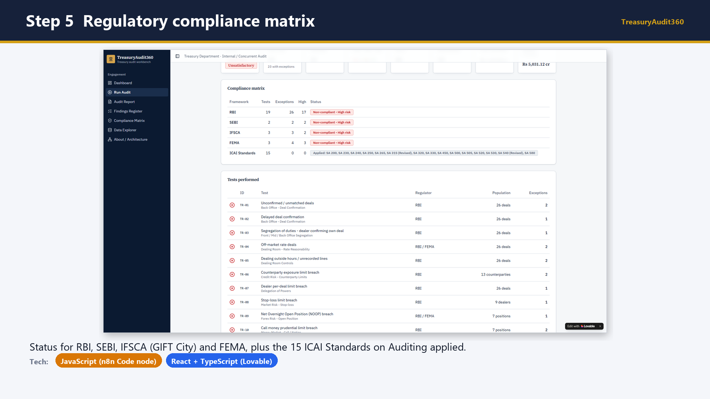
Notes:
Slide 22 - Step 5 Regulatory compliance matrix
Say: Explain the compliance matrix by regulator and the ICAI standards applied.

Slide 23
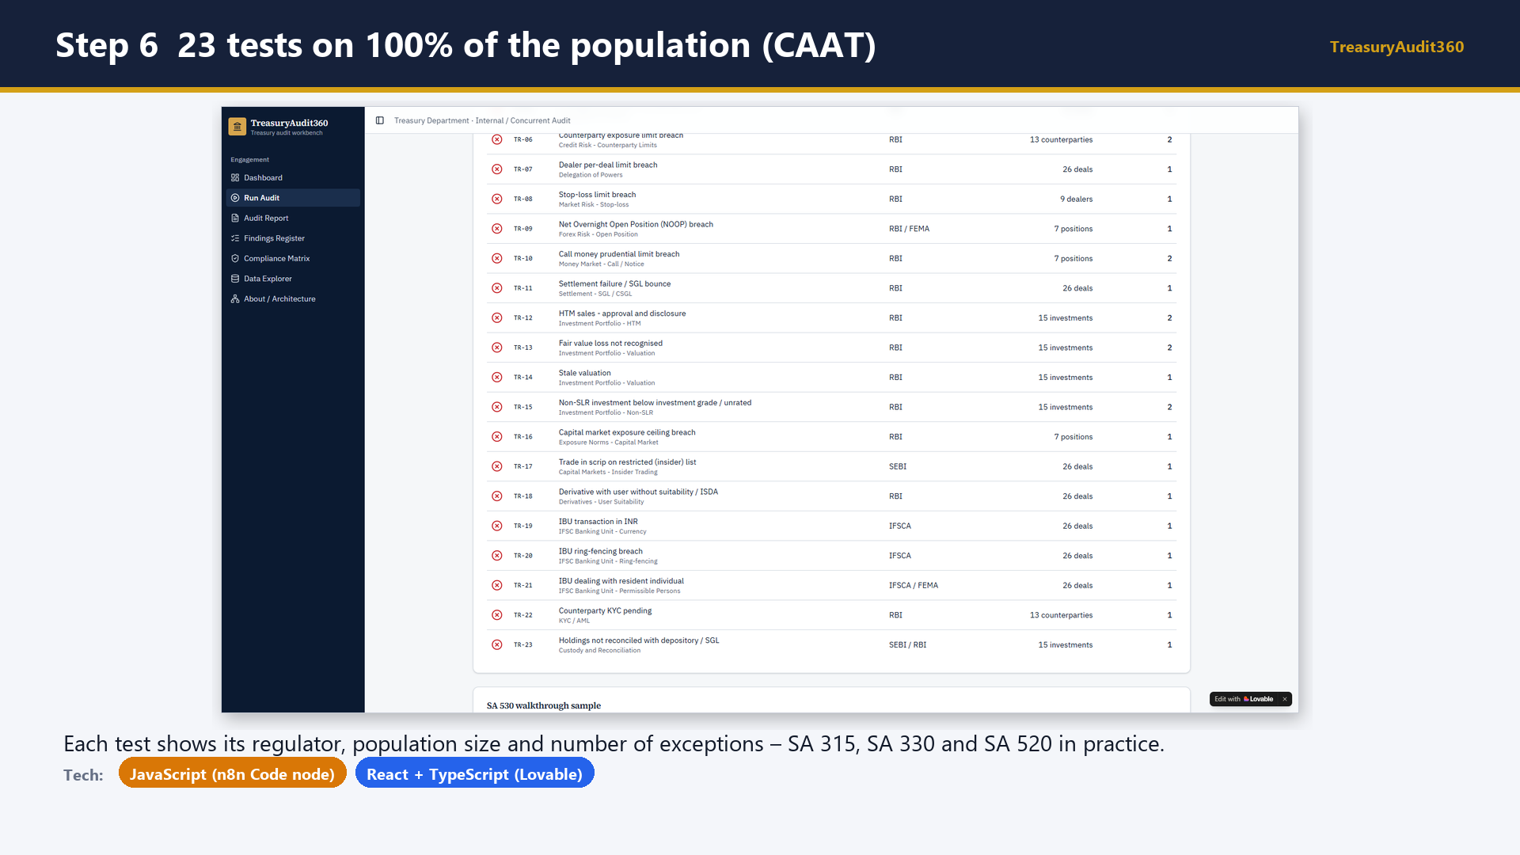
Notes:
Slide 23 - Step 6 23 tests on 100% of the population (CAAT)
Say: Scroll the tests performed, showing population and exceptions for each test.

Slide 24
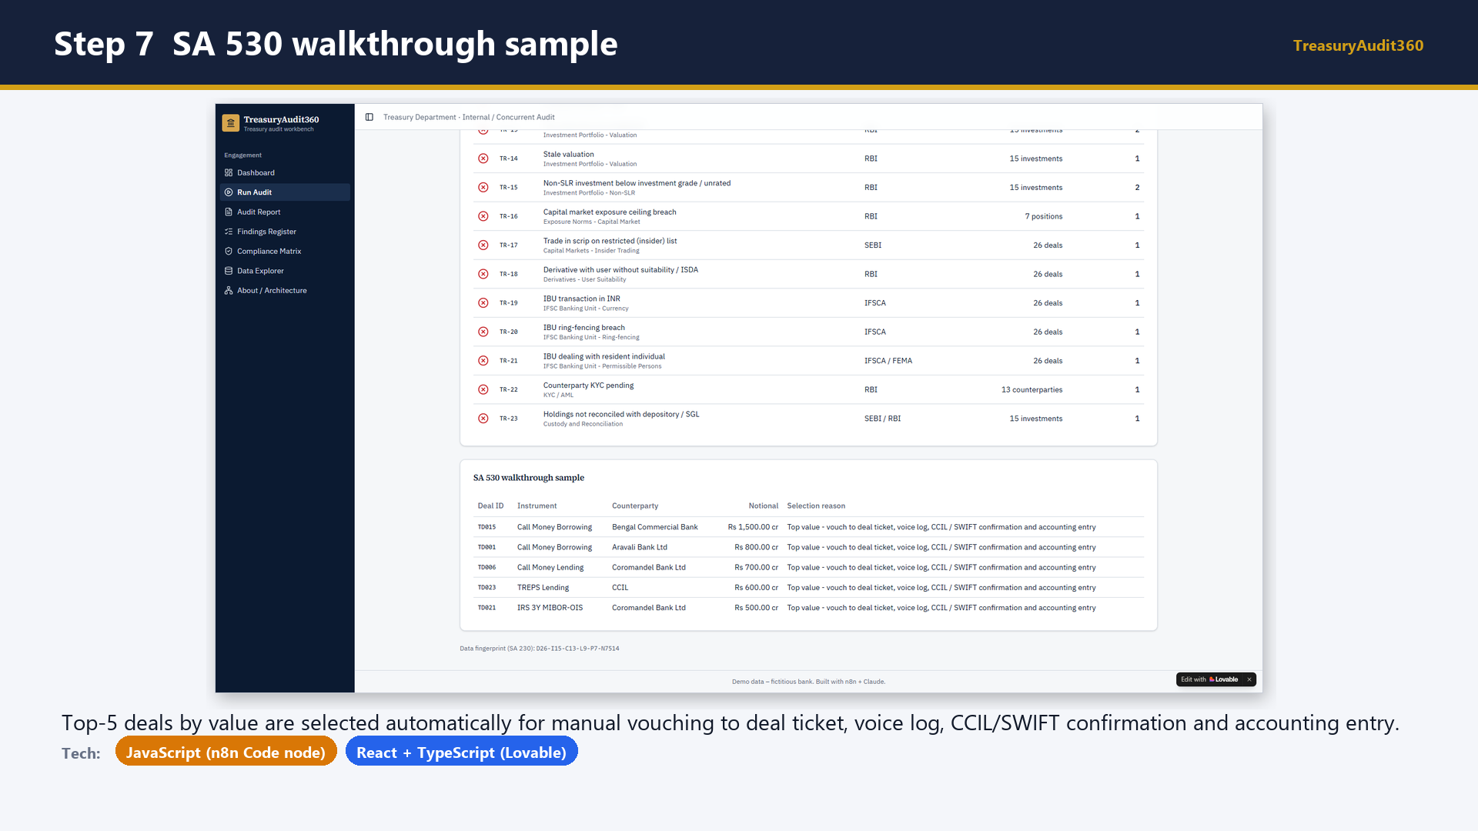
Notes:
Slide 24 - Step 7 SA 530 walkthrough sample
Say: Explain that full-population testing replaces statistical sampling, but a walkthrough sample is still selected for vouching.

Slide 25
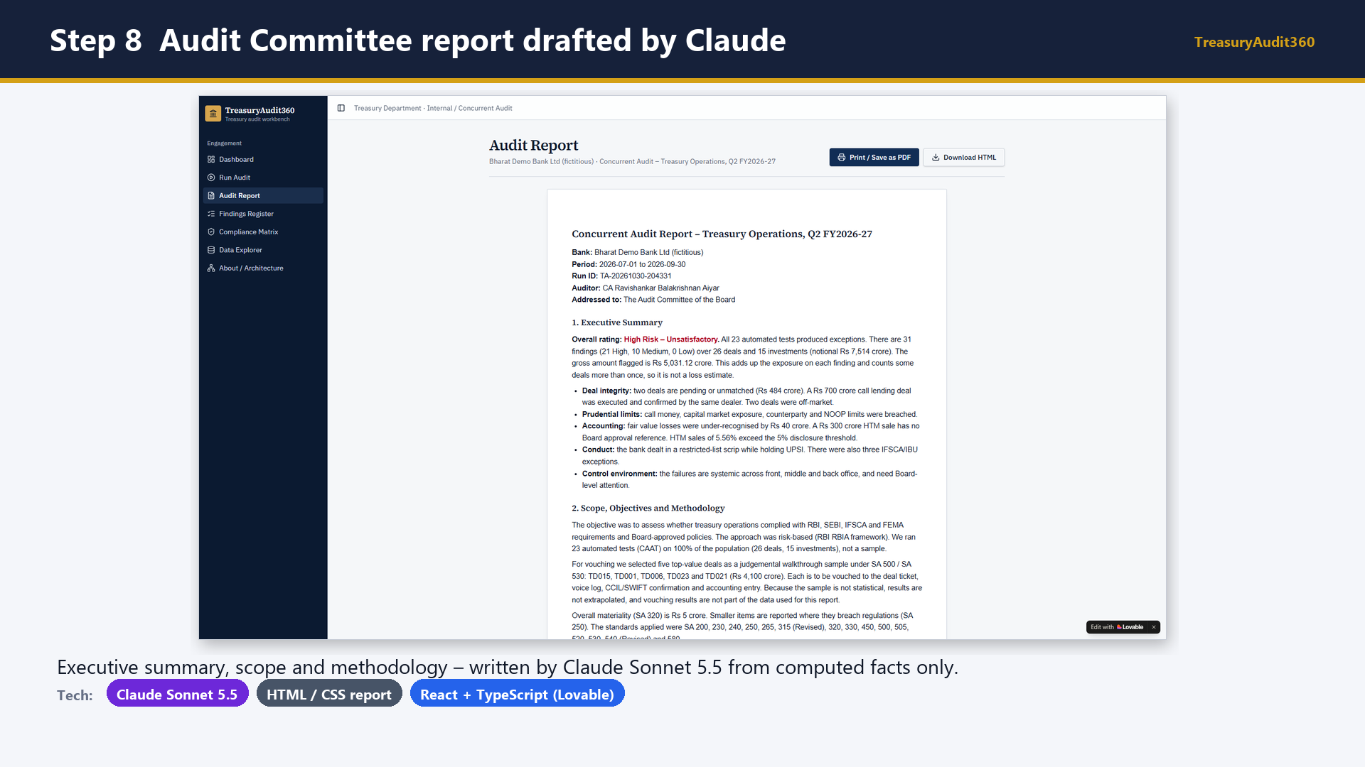
Notes:
Slide 25 - Step 8 Audit Committee report drafted by Claude
Say: Open the Audit Report page and read the executive summary.

Slide 26
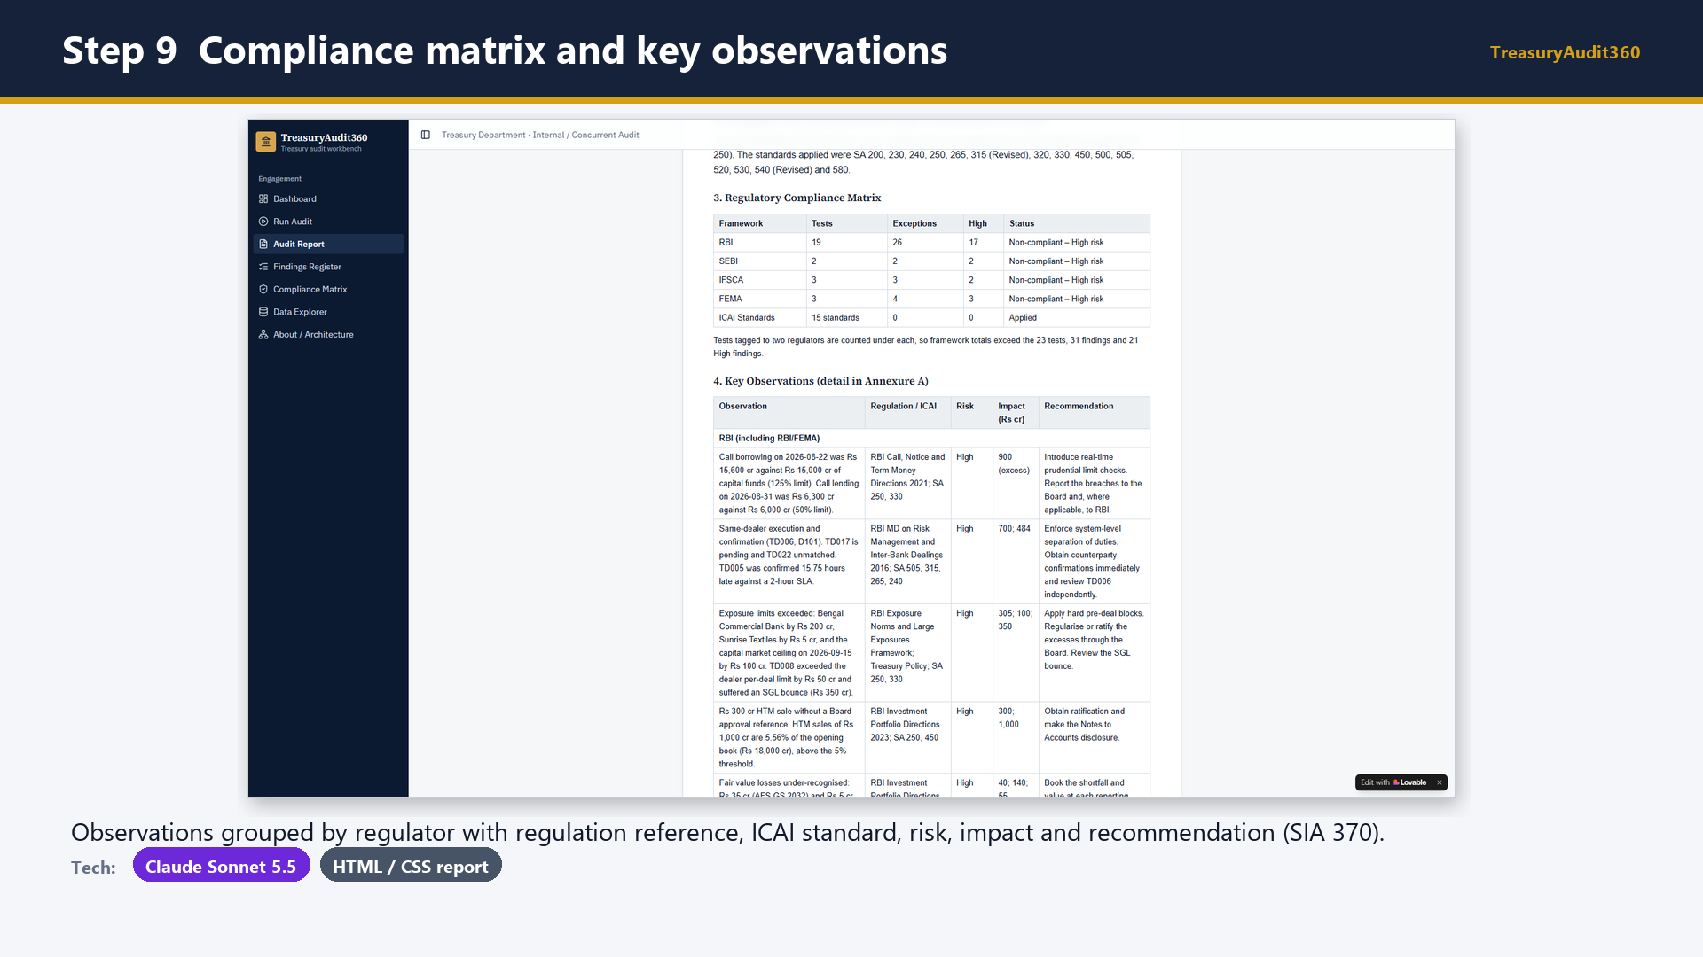
Notes:
Slide 26 - Step 9 Compliance matrix and key observations
Say: Scroll to the observations grouped by regulator.

Slide 27
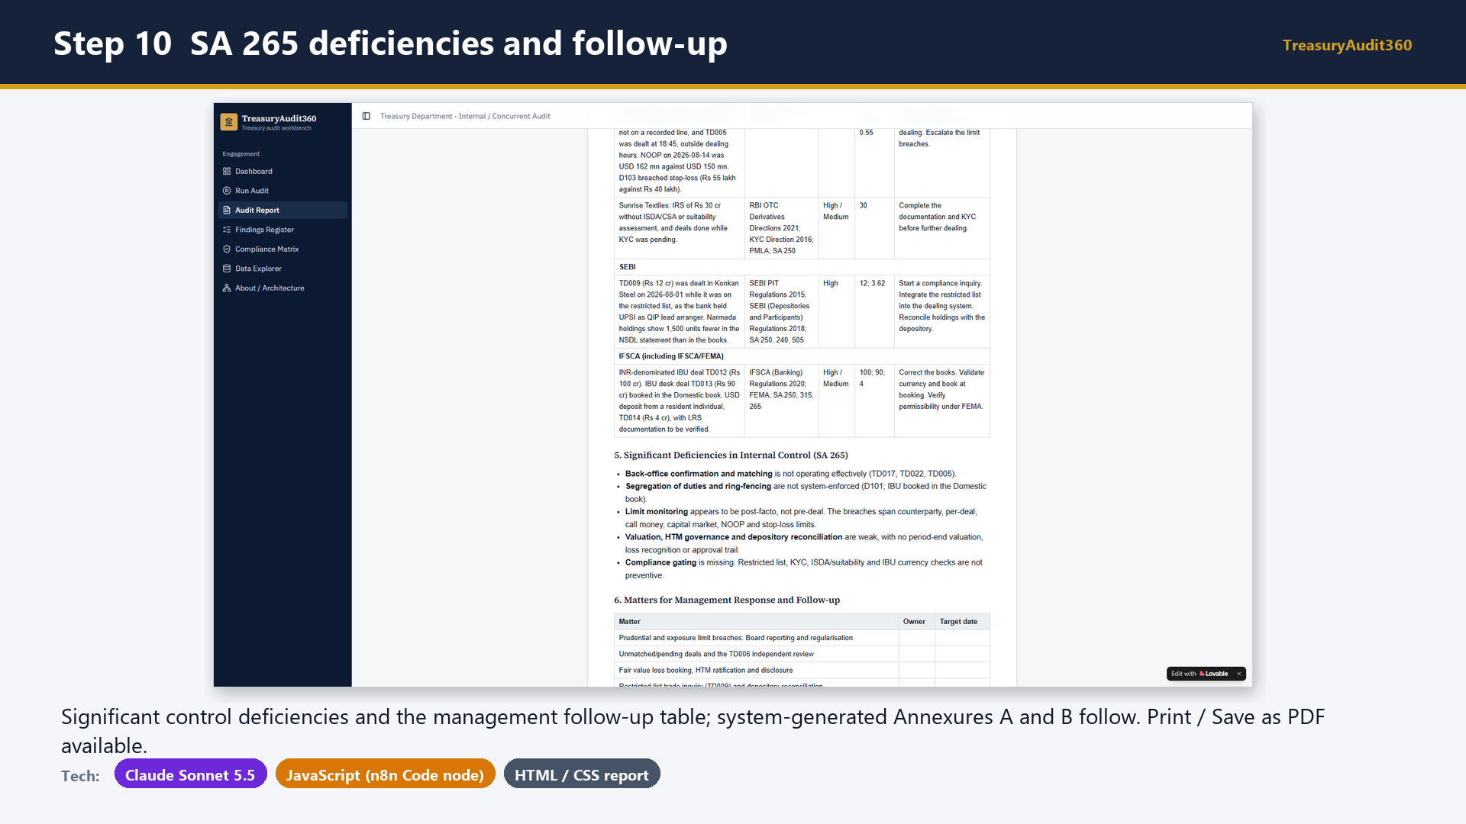
Notes:
Slide 27 - Step 10 SA 265 deficiencies and follow-up
Say: Show the SA 265 section, the follow-up table and the Print to PDF button.

Slide 28
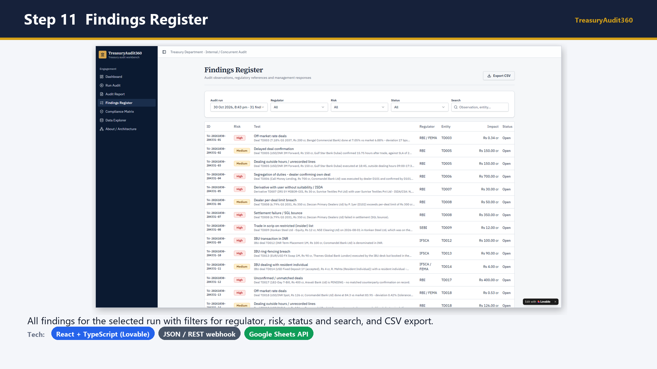
Notes:
Slide 28 - Step 11 Findings Register
Say: Open the Findings Register and filter by regulator, for example IFSCA or SEBI.

Slide 29
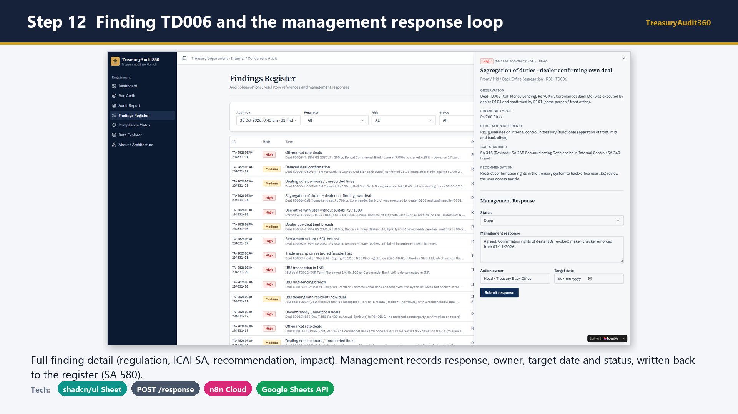
Notes:
Slide 29 - Step 12 Finding TD006 and the management response loop
Say: Open finding TD006, where the dealer confirmed their own deal, read the details, then enter a management response and submit. Show the Findings tab in Google Sheets updated.

Slide 30
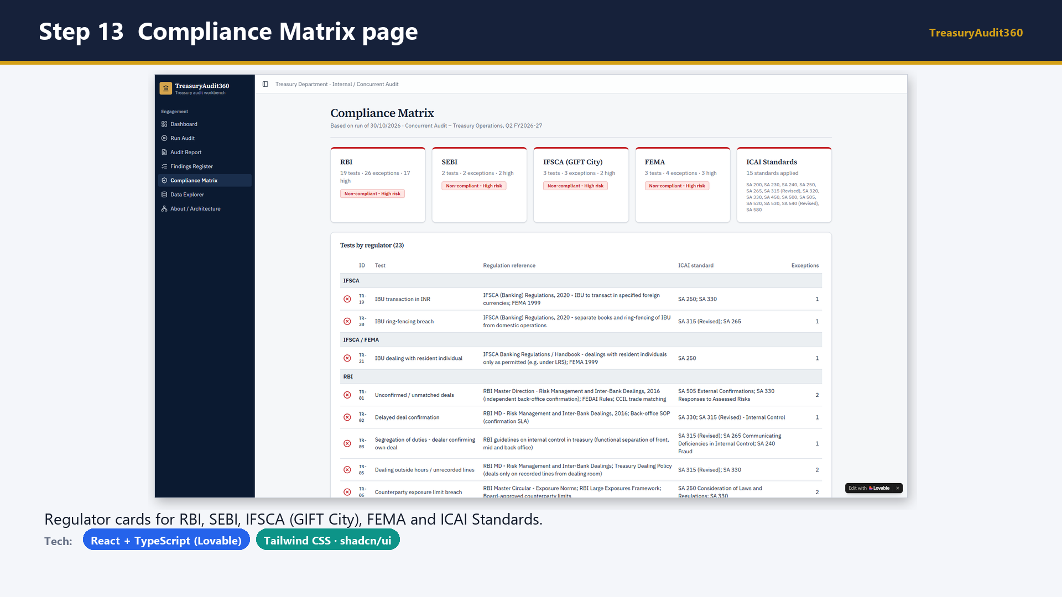
Notes:
Slide 30 - Step 13 Compliance Matrix page
Say: Show the compliance matrix page with a card per regulator.

Slide 31
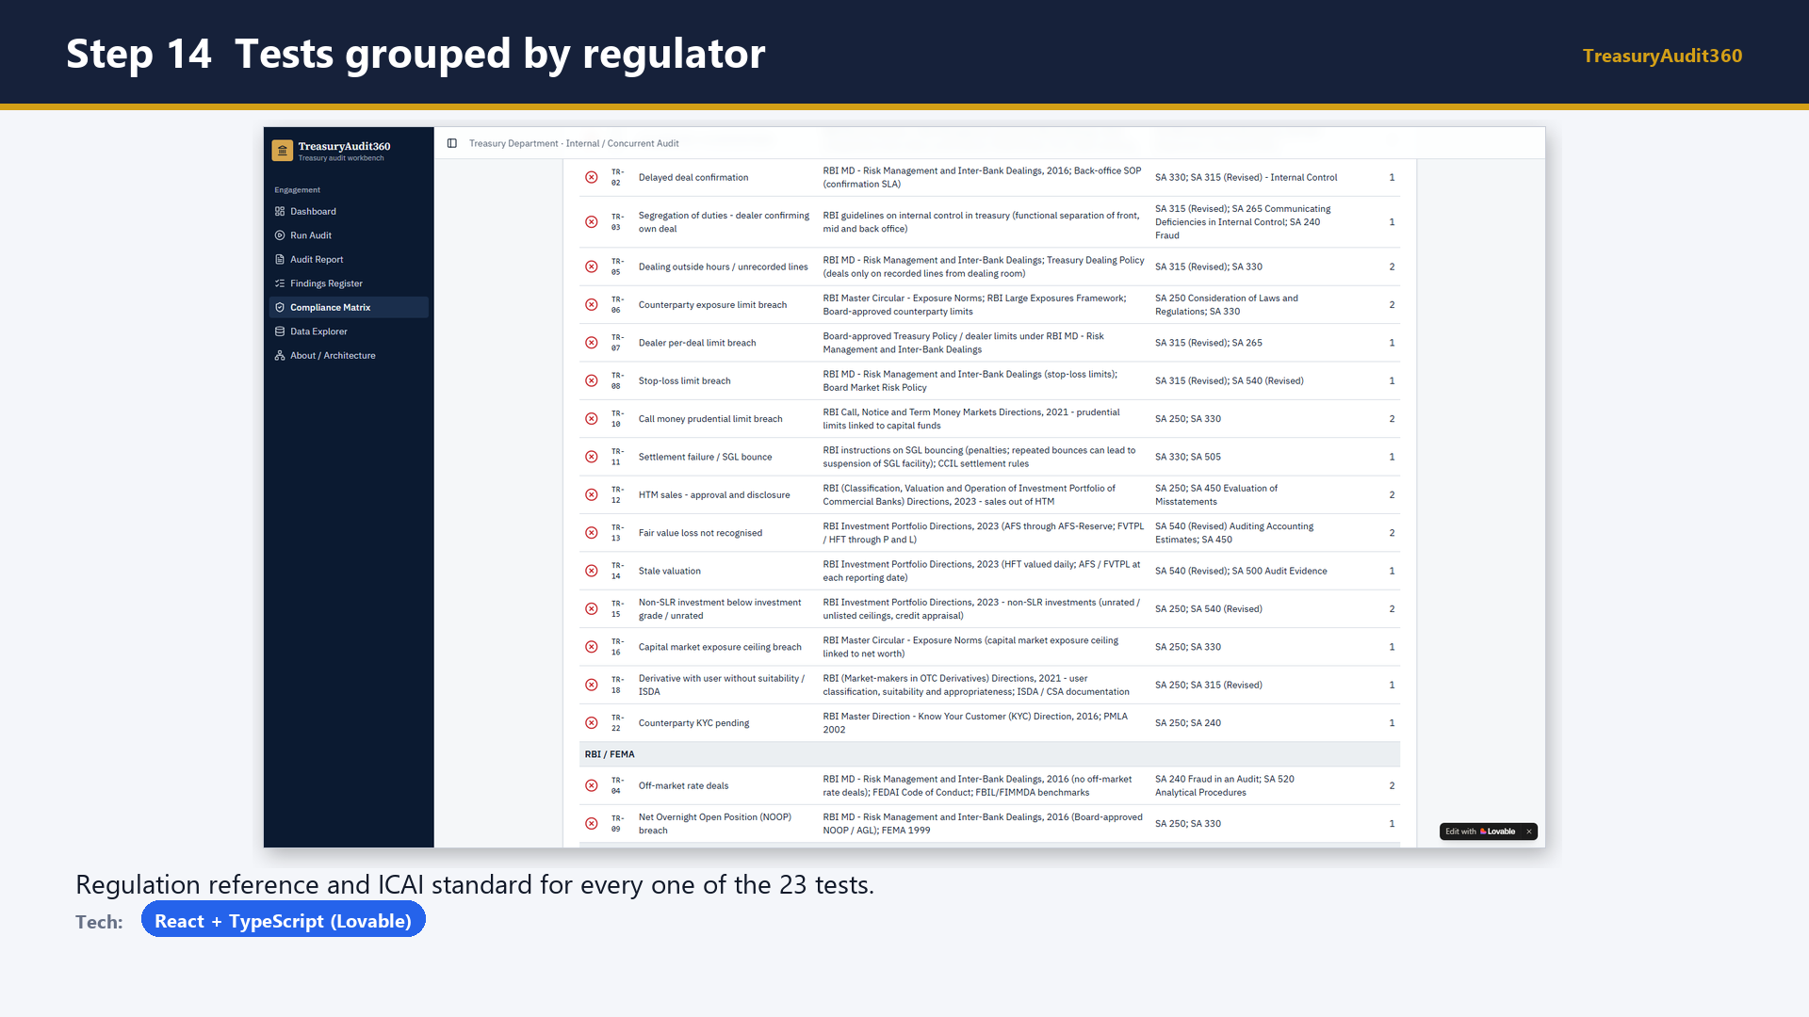
Notes:
Slide 31 - Step 14 Tests grouped by regulator
Say: Scroll through the tests grouped by regulator.

Slide 32
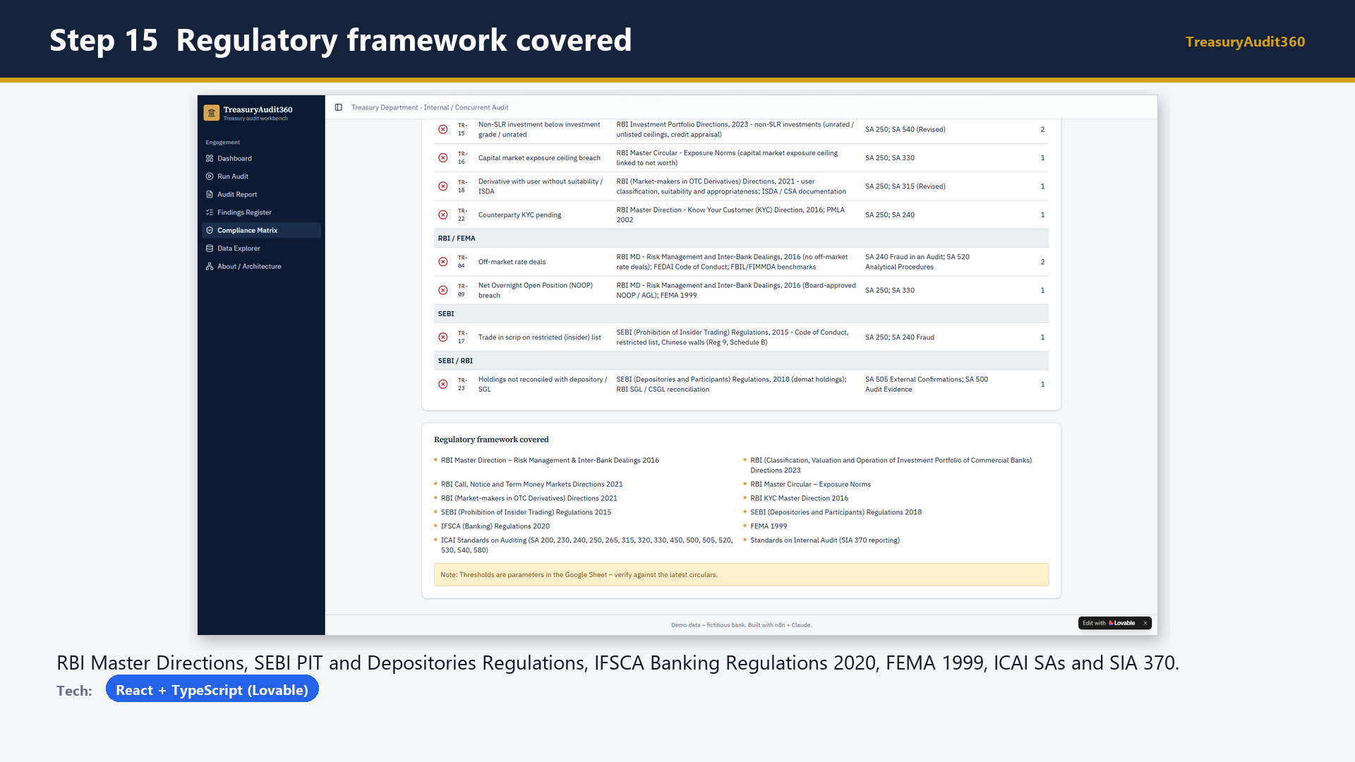
Notes:
Slide 32 - Step 15 Regulatory framework covered
Say: Read out the regulatory framework covered and the note to verify thresholds against current circulars.

Slide 33
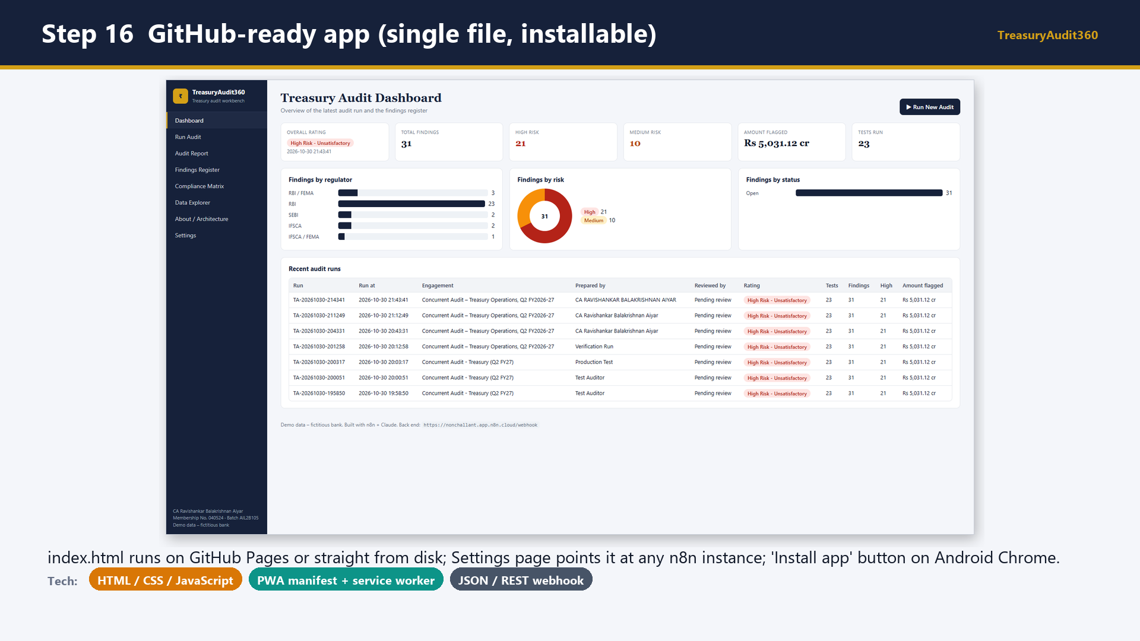
Notes:
Slide 33 - Step 16 GitHub-ready app (single file, installable)
Say: Show the GitHub version: one HTML file, no build step, installable as an app, with the n8n workflows and sample data in the same repository.

Slide 34
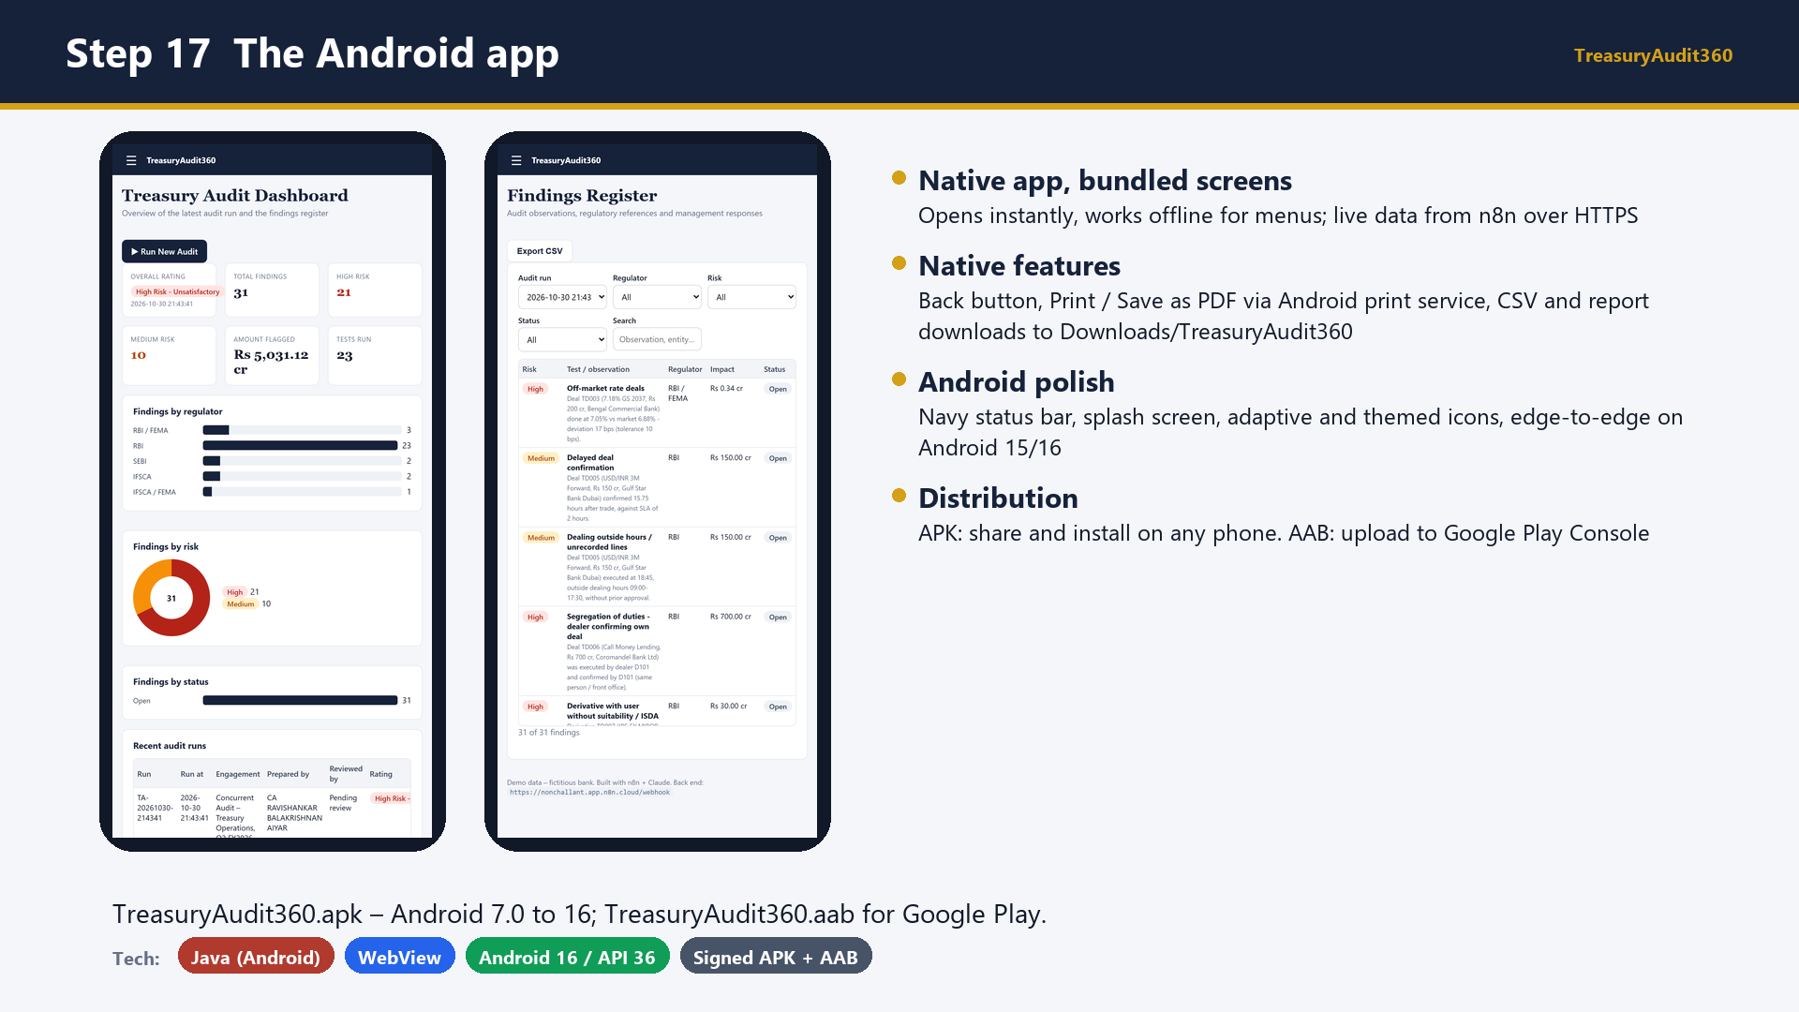
Notes:
Slide 34 - Step 17 The Android app
Say: Show the Android app on a phone: the same dashboard and findings register, full screen in the navy theme. Mention the APK for direct install and the AAB for the Play Store.

Slide 35
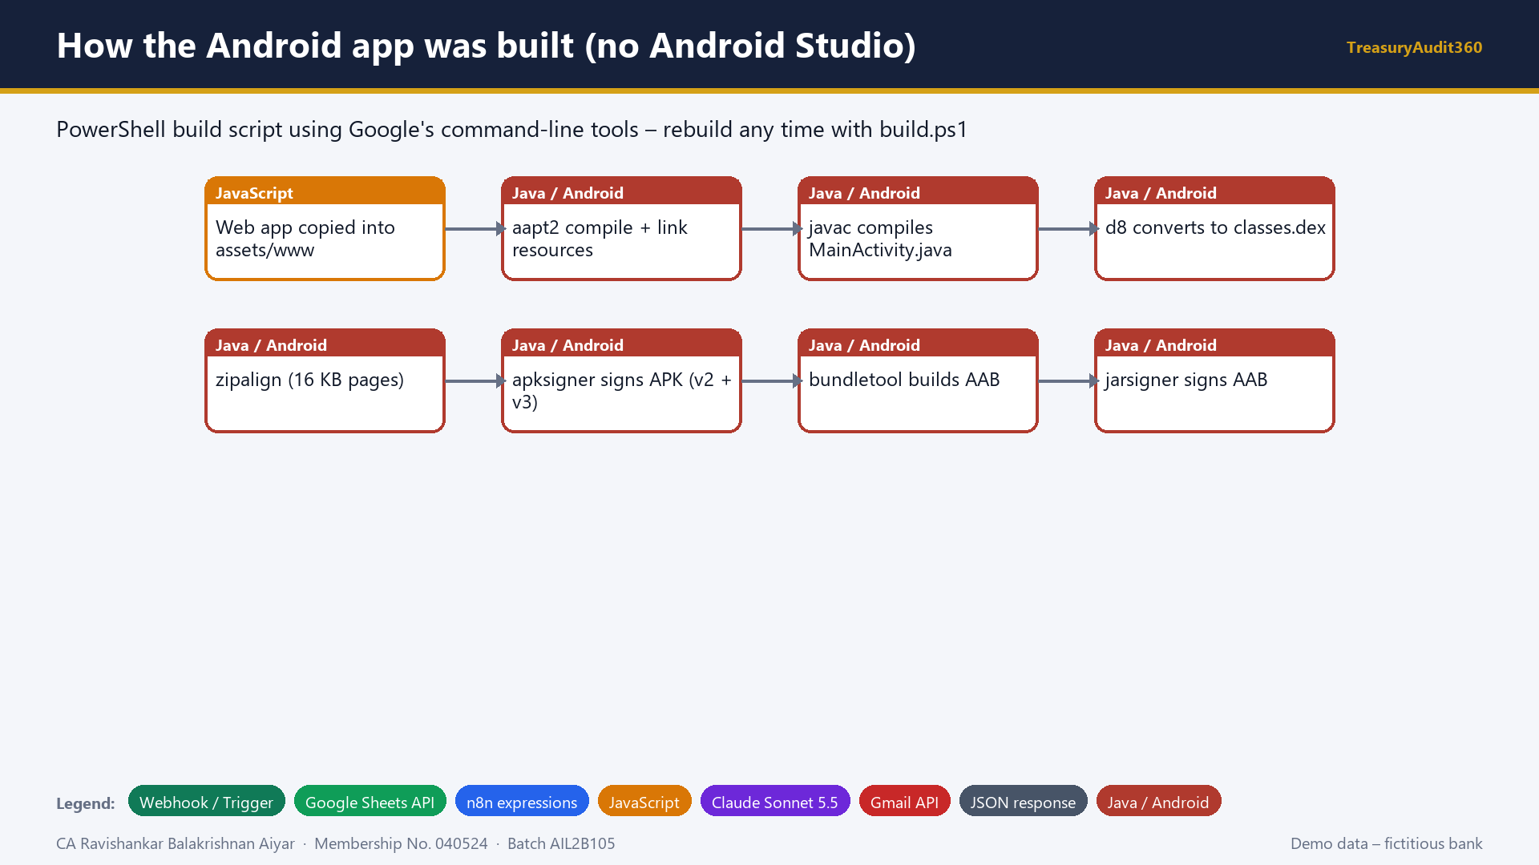
Notes:
Slide 35 - How the Android app was built (no Android Studio)
Say: Explain the build: resources compiled with aapt2, Java compiled and converted to Android bytecode, aligned and signed into an APK, and bundled into an AAB for Google Play.

Slide 36
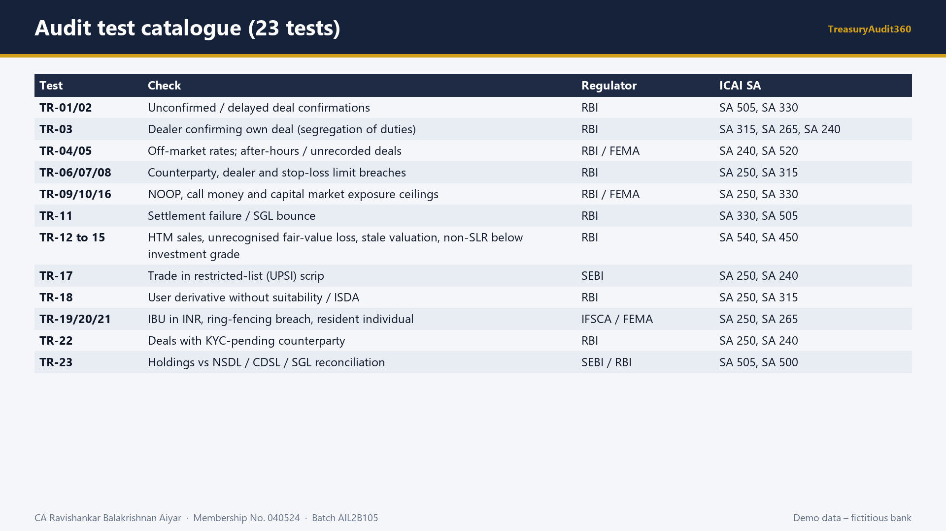
Notes:
Slide 36 - Audit test catalogue (23 tests)
Say: Summarise the 23 tests and their regulator and ICAI standard mapping.

Slide 37
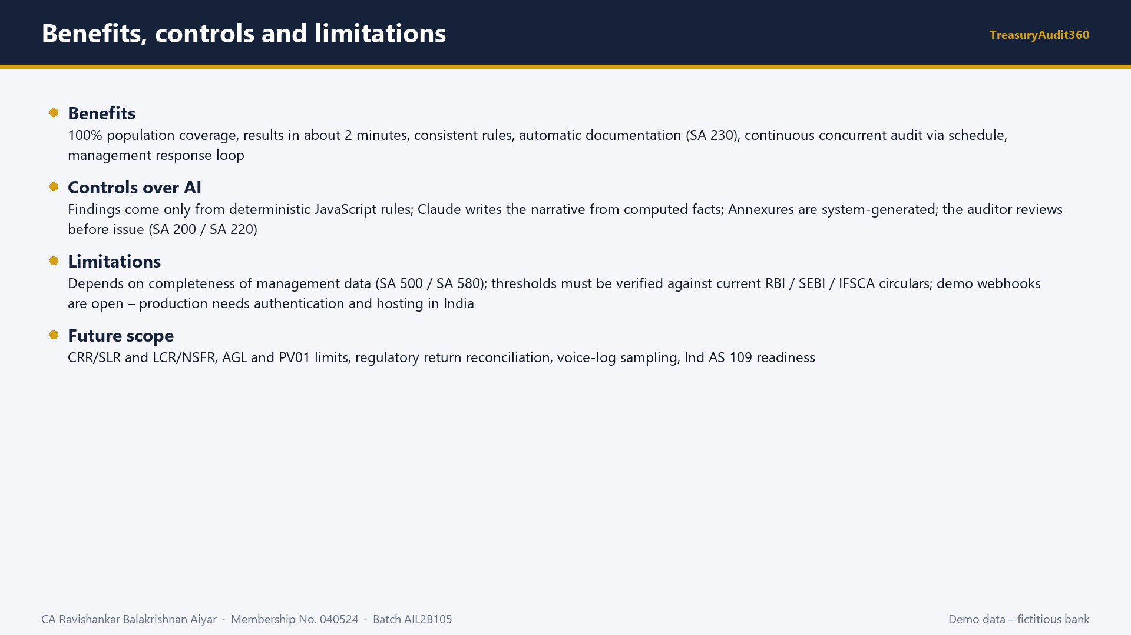
Notes:
Slide 37 - Benefits, controls and limitations
Say: Close with benefits, the controls over AI, the limitations and future scope.

Slide 38
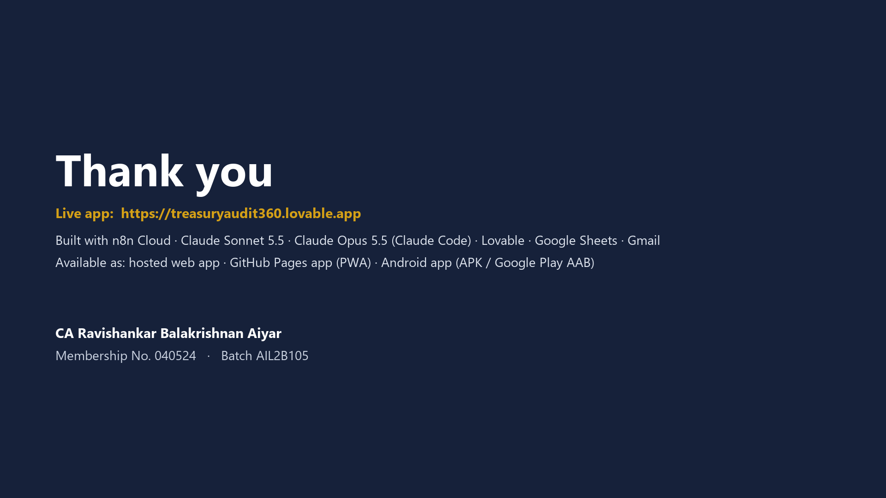
Notes:
Slide 38 - Thank you
Say: Thank the panel and give the live link.

